Slide 1

The
Global
Early Adolescent Study
Robert Wm. Blum MD, PhD, MPH
Professor and Director
Global Early Adolescent Study
Johns Hopkins University
George Washington University
Mini University
Oct 22, 2018

Slide 2

Study Overview
Formative Research
Longitudinal Research
Baseline Findings
The age of puberty is declining globally.
Over the past 20 years our understanding of adolescent development has expanded dramatically with a particular focus on the plasticity of the adolescent brain.
With puberty a girl’s world shrink while a boy’s world expands.
WHY
EARLY ADOLESCENCE?

Slide 3
Study Overview
Formative Research
Longitudinal Research
Baseline Findings
Solidification of gender norms and roles
Experiences of gender-based violence and Interpersonal Violence Increase starting at age 10
With the onset of puberty in early adolescence experiences of FGM/C and child marriage also increase.
The gender solidification hypothesis indicates that there is a greater opportunity for gender equality in childhood and early adolescence, but attitudes solidify by approximately age 16.
Both boys and girls are harmed by gender inequalities.
WHY
EARLY ADOLESCENCE AND GENDER?

Slide 4
Study Overview
Formative Research
Longitudinal Research
Baseline Findings
Gender roles starts to expand at about age 10
Institutions such as the education system and faith organizations tend to reinforce gender inequalities.
Poverty exacerbates gender inequalities as young people compete for scarce resources.
Rigidity of social norms are inverse to education.
CONTEXTS AND GENDER INTERACT

Slide 5

Study Overview
Formative Research
Longitudinal Research
Baseline Findings
THE GLOBAL EARLY ADOLESCENT STUDY

Slide 6

Study Overview
Formative Research
Longitudinal Research
Baseline Findings
The GEAS seeks to understand the factors in adolescence that shape healthy development in the adolescent years.
Longitudinal research study
Global comparison
Evaluating the impact of gender transformative interventions

Slide 7
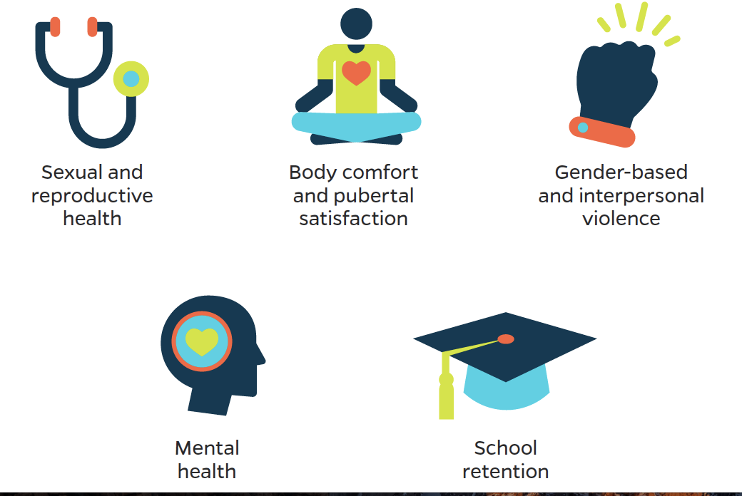
Study Overview
Formative Research
Longitudinal Research
Baseline Findings
KEY
OUTCOMES

Slide 8

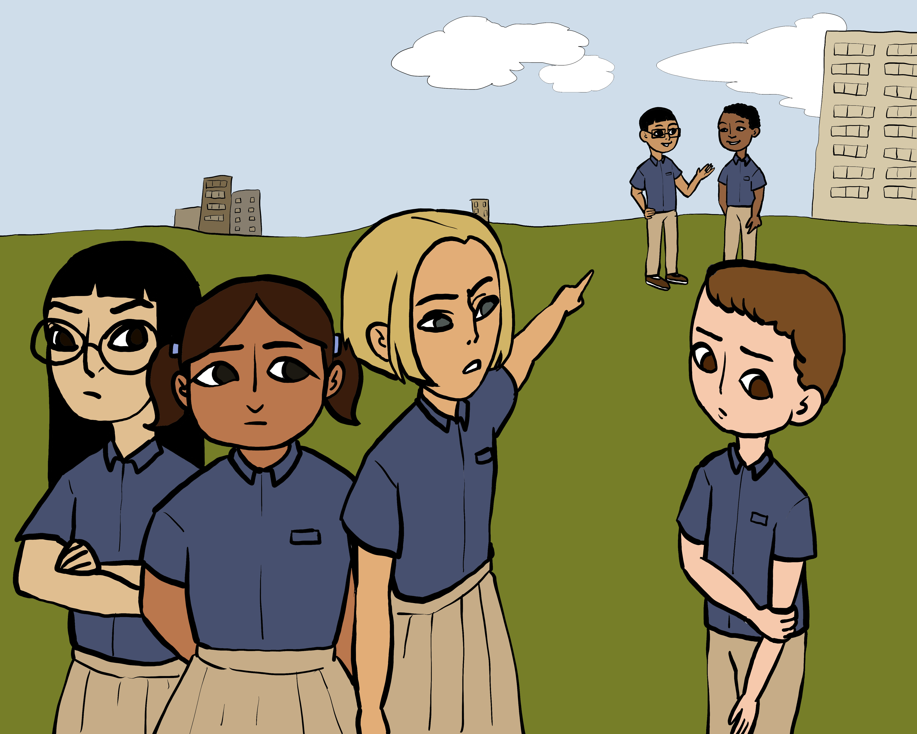
Study Overview
Formative Research
Longitudinal Research
Baseline Findings
Three measures:
Ten module health instrument
  Health: physical, mental and sexual health
  Contexts: family, peers, school, community, adversities
  Empowerment, interpersonal and gender based violence
Gender Norms
Vignettes-based measure of gender equality in relationships
Notes:
Health – contextual factors including family, school and neighborhood, pubertal development, interpersonal violence, sexual & reproductive health
Gender norms – assessment of traditional statements about gender expectations and roles
Vignettes –

Slide 9
Study Overview
Formative Research
Longitudinal Research
Baseline Findings
Edinburgh,
Scotland
Ghent
Belgium
Baltimore, USA
Assiut, Egypt
Shanghai,
China
Ouagadougou, Burkina Faso
New Delhi,
India
Nairobi,
Kenya
Hanoi,
Vietnam
Cuenca,
Ecuador
Ile-Ife, Nigeria
Kinshasa, DRC
Blantyre,
Malawi
Cochabamba, Bolivia
Cape Town,
South Africa
Formative, mixed-methods research
Based on qualitative data collection as basis
  Narrative interviews of 35 adolescent-parent diads in each country
  Timeline activities exploring age of anticipated events
Face validity testing
2 rounds of pilot testing of instruments
INSTRUMENT
DEVELOPMENT

Slide 10
Study Overview
Formative Research
Longitudinal Research
Baseline Findings
Systematic review exploring factors shaping gender norms among early adolescents
Methodological Papers
  Gender Norms
  Adverse Child Experiences
  Empowerment
  Gender Equality
Journal of Adolescent Health Special Supplement
  6 Publications of Qualitative Findings
  1 Editorial
  3 Commentaries
  1 Review
FORMATIVE
RESEARCH
PRODUCTS

Slide 11
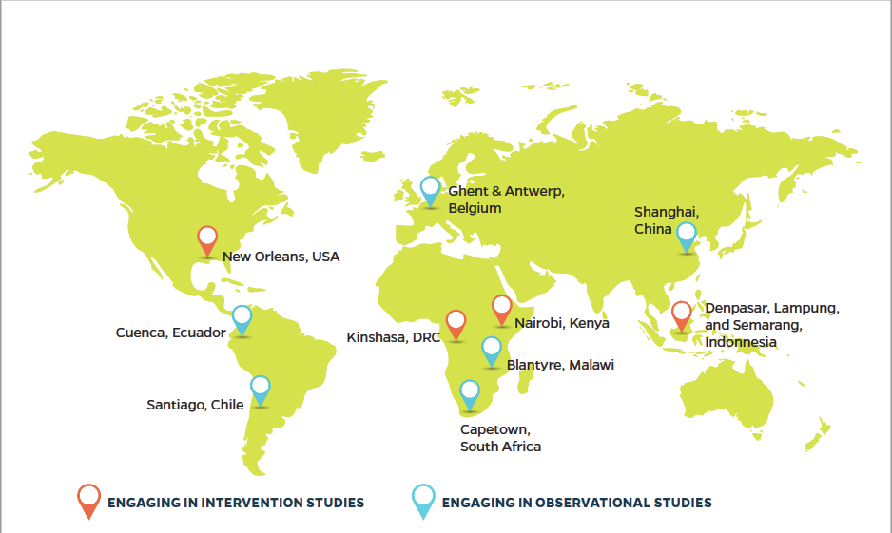
Study Overview
Formative Research
Longitudinal Research
Baseline Findings
LONGITUDINAL STUDY
SITES
Notes:
Boys and girls ages 10-14 living in resource-constrained settings in major cities worldwide.

Slide 12
Study Overview
Formative Research
Longitudinal Research
Baseline Findings
What are the factors related to gender equitable and inequitable gender norms?
  How do they vary by site?
How do gender norms & perception of gender equality evolve over time ?
How do gender norms and perceived gender equality at both the individual and community levels related to adolescent health outcomes over time?
  How do these influences vary by setting?
How do gender transformative interventions shift gender norms and how does this affect health trajectories for boys and girls?
LONGITUDINAL
RESEARCH
OBJECTIVES

Slide 13


Measuring empowerment among adolescents age 10-14 in the Global Early Adolescent Study

Slide 14
Empowerment
The concept of enhancing an individual’s or group’s capacity to make effective choices; that is, to make choices and then transform these choices into desired actions and outcomes.
                The World Bank

Slide 15
GEAS conceptual model for empowerment among adolescents age 10-14
Agency
Opportunity Structures
Economic
Political
Cultural
Family
Legal
Education
Social capital
Voice
Ability to express opinions and be heard
Ability to express needs and desires
Self-actualization
Achievement of desired outcomes
Education
Employment
Healthy behaviors
Freedom of Movement
Ability to meet with friends
Ability to participate in recreational activities
Decision-making
Ability to make decisions that govern daily life
Notes:
agency is malleable and that is where interventions are focused. Agency works through opportunity structure to increase self-actualization and not the other way around

Slide 16
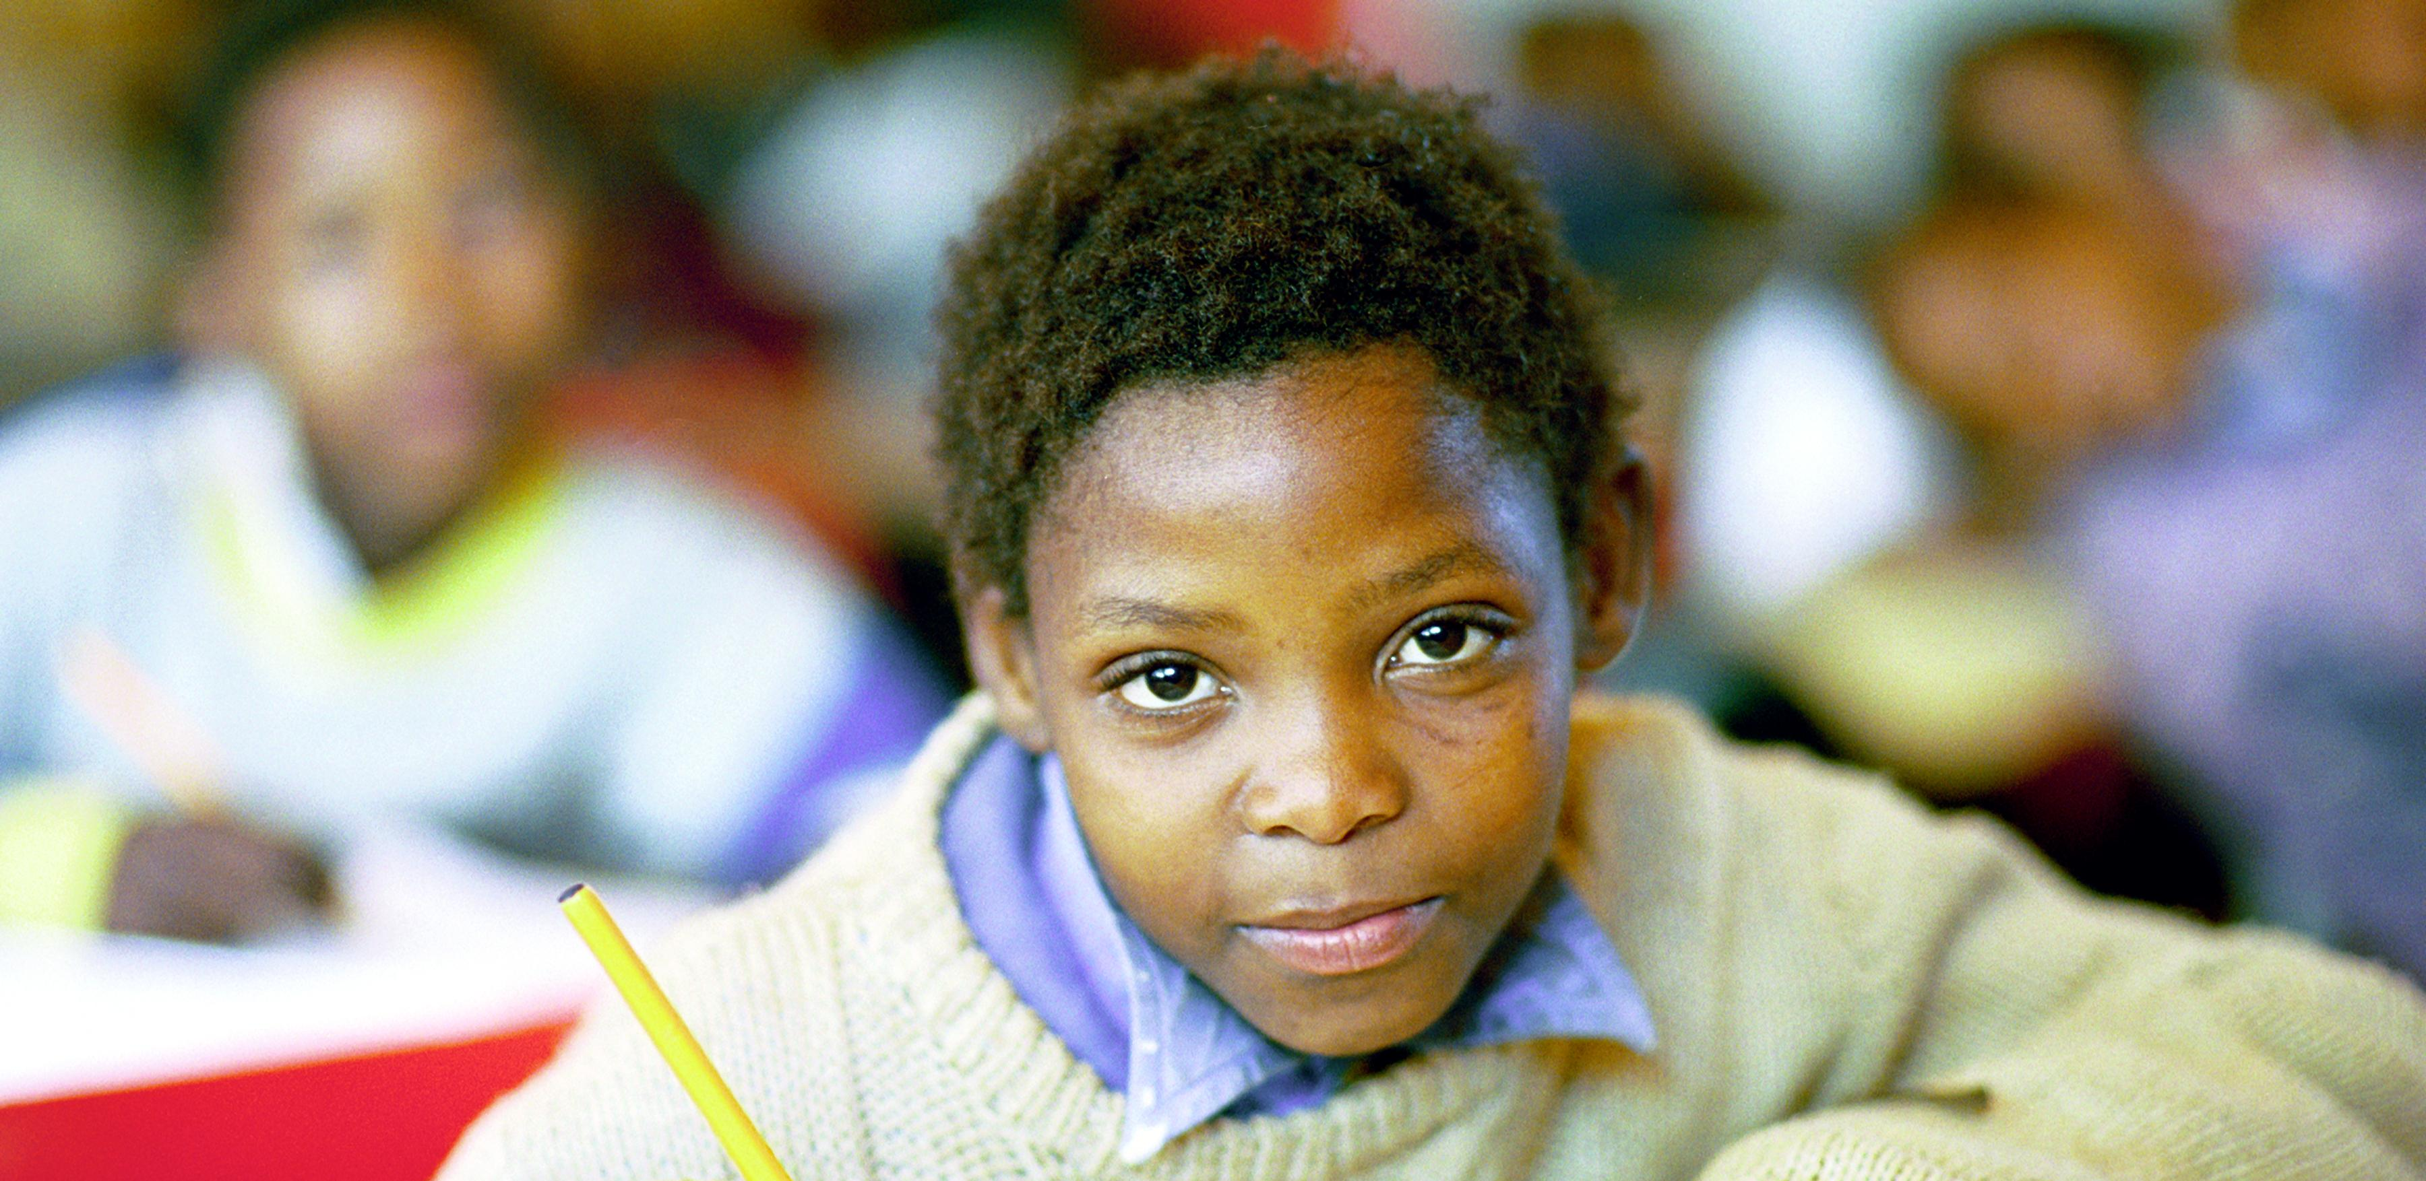
Methodology and Results

Slide 17
Data
Used data from Phase I of GEAS
  Implemented in 14 cities between November 2015 and September 2016
  Administered to 120 adolescent age 10-14 in each site
    Oversample of 375 in Kenya
Adolescents were recruited from schools and community centers in urban poor communities
Interviews conducted primarily by self-administered on mobile tablets via Computer Assisted Self Interview (CASI) or Audio-CASI

Slide 18
Measure Selection
Identified four specific domains hypothesized to be relevant to this age group and across cultures
  Voice
  Behavioral control and decision making
  Freedom of movement
  Economic Empowerment
Identified questions fielded in other surveys and modified to include as items within a sub-scale

Slide 19
Three Dimensions of Empowerment for Early Adolescents
Study Overview
Formative Research
Longitudinal Research
Baseline Findings
Item | Voice | Freedom of Movement | Behavioral Control
Go to after school activities (like sports clubs) | 0.16 | 0.54 | 0.28
Go to a party with boys and girls | 0.04 | 0.75 | 0.08
Meet with friends after school | 0.20 | 0.58 | 0.20
Got to community center/movies/youth center | 0.15 | 0.76 | 0.10
Visit a friend of the opposite sex | 0.15 | 0.71 | 0.08
My parents or guardians ask for my opinion on things | 0.60 | 0.25 | 0.16
My parents of guardian listen when I share my opinion | 0.67 | 0.14 | 0.18
My friends ask my advice when they have a problem | 0.62 | 0.19 | 0.20
If I see something wrong in school or the neighborhood I feel I can tell someone and they will listen | 0.65 | 0.17 | 0.13
I can speak up in class when I have a comment or question | 0.64 | 0.04 | 0.23
I can speak up when I see someone else being hurt | 0.68 | 0.16 | 0.13
I can ask adults for help when I need it | 0.61 | 0.05 | 0.18
What clothes to wear when you are not in school/working | 0.18 | 0.13 | 0.65
What to do in your free time | 0.22 | 0.24 | 0.66
What to eat when you are not at home | 0.16 | 0.24 | 0.62
How much education you will get | 0.25 | 0.04 | 0.47
Who you can have as friends | 0.21 | 0.01 | 0.61
Cronbach's Alpha | 0.80 | 0.75 | 0.71
Total % of Variance Explained | 42.97% | 34.80% | 29.81%

Slide 20
Measures – Economic Empowerment
In the last 6 months did you do anything to get money? | Items | Response Options
 | What did you do in the last 6 months to earn money (check as many as apply)? | Day labor or temporary work Worked for family (such as parents or relatives) Worked for neighbors or friends Doing odd jobs Providing services (such as babysitting, hair styling, nail art, selling things like water or cigarettes, washing cars, Begging, panhandling or garbage-picking Part or full-time job
 | In the past 6 months have you received gifts of money (including from a boyfriend or girlfriend) | No Yes
 | If you did get money over the past 6 months where did you get the money from (check all that apply): | a. Mother/father b. Boyfriend/Girlfriend c. Other friend d. Other family member e. Other
 | Who decided how the money you earned/received over the past 6 months was spent? Check all that apply | a. Me b. Mother c. Father d. Boyfriend/ Girlfriend e. Other friend f. Other family member g. There was never a discussion; it was expected that I give it to my family h.Other

Slide 21
Economic Empowerment
Items did not scale
May work as discrete items
Dropped from the Empowerment measure not because it is irrelevant but because it did not form part of a coherent measure of empowerment

Slide 22
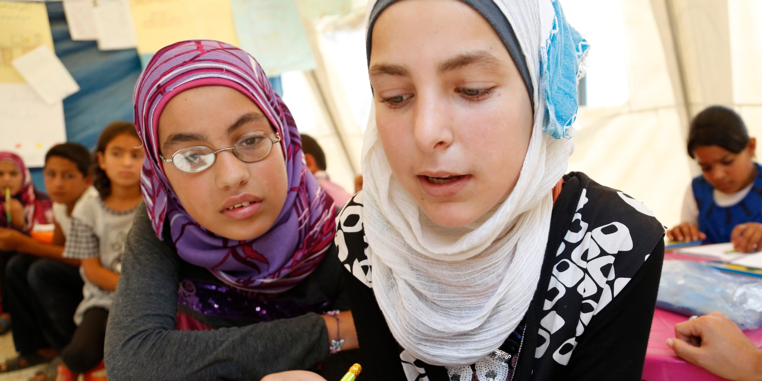
Discussion

Slide 23
Discussion
Evidence that overall the three dimensions of voice, freedom of movement and behavioral control are dimensions within a larger construct
Voice appears to be a more universal construct than freedom of movement or behavioral control
Specific items demonstrate that context matters and scales need to be adapted to reflect this
The three dimensions are more measures of agency than empowerment
Economic empowerment, while important, does not scale.

Slide 24
The GEAS Partners:
Rutgers, Netherlands
University of St. Andrews, Scotland
Ghent
University, Belgium
Shanghai Institute of Planned Parenthood Research, China
Institute of Women and Ethnic Studies, USA
Assiut University, Upper Egypt
University of Ouagadougou, Burkina Faso
Population Council, New Delhi, India
African Population and Health Research Center (APHRC), Nairobi, Kenya
Academy of Social Sciences Institute for Sociology, Hanoi, Vietnam
Obafemi Awolowo University , Ile-Ife, Nigeria
University of Cuenca
Universitas Gadja Mada, Indonesia
University of Kinshasa, DRC
University of Malawi, Blantyre, Malawi
Institute for Human Development, Bolivia
University of the Western Cape, South Africa
Johns Hopkins GEAS Coordinating Center
GEAS Donors
Robert Blum, MD, MPH, PhD
Caroline Moreau, MD, PhD
Leah Koenig MSPH
Kristin Mmari, Dr.PH
Linnea Zimmerman, PhD
Lori Heise, PhD
Mengmeng Li, MSPH
Mark Emerson
Quinn Barnette
Linda Boche
Bill & Melinda Gates Foundation
David & Lucile Packard Foundation
Save the Children
UNFPA
USAID
WHO
Ford Foundation
Flemish government
Scottish government

Slide 25

Thank you!

