Slide 1
Paying Attention to the two R’s in qualitative research

Slide 2
Reflexivity: A Process of Reflection
Qualitative interviewing involves a continuous process of reflection on the research
Reflexivity is the process of examining oneself as a researcher and the research relationship
Includes examining ones’ assumptions & preconceptions, and how these affect research decisions (including the selection and wording of questions)
.
The Global Early Adolescent Study: The Two R’s

Slide 3
Reflexivity Cont
Reflecting on the research relationship involves examining ones’ relationship to the participant and how the relationship dynamics affect responses to the questions
How we interview (or write) is a reflection of our own interpretation based on the cultural, social, gender, class and personal politics that we bring to the research
The Global Early Adolescent Study: The Two R’s

Slide 4
An Exercise
Reflect on the first time you got your menstruation (if you are a woman) or had a wet dream (if you are a man).
What were you feelings or reactions?
The Global Early Adolescent Study: The Two R’s

Slide 5
Applied to the GEAS
How might this shape your questioning/interpretation of a young person about menstruation/wet dreams?
More specifically from the protocol:
“When does Mary stop being a child? How does she know?”
The Global Early Adolescent Study: The Two R’s
Notes:
*if asked a girl about menstruation (or boy about wet dream) – what might their questioning be laden with? How might it color/bias what they ask and/or hear in the response?
*what are your own memories/experiences of being a child and when you felt you no longer were? How might that shape your questioning and listening? And interpretation?

Slide 6
Reflexivity
The idea that a person’s thoughts and ideas tend to be inherently biased (and hence, how this influences his/her research).
Other examples of relevance to the GEAS?
The Global Early Adolescent Study: The Two R’s
Notes:
*if asked a girl about menstruation (or boy about wet dream) – what might their questioning be laden with? How might it color/bias what they ask and/or hear in the response?
*what are your own memories/experiences of being a child and when you felt you no longer were? How might that shape your questioning and listening? And interpretation?

Slide 7
The Challenge of Reactivity
The challenge that the subjects of social research may react to the experience of being studied, thus changing their behavior from what would have been response under normal (non-observed, non-studied) behavior
Can affect the validity of the research
The Global Early Adolescent Study: The Two R’s
Notes:
*particularly a challenge in ethnography when are observing situations (and the participants know they are being observed)
* Cannot eliminate the presence/influence of the researcher so need to be aware of it --- long term involvement, triangulation of data, other methods help to ascertain/manage the validity

Slide 8
An Exercise
Imagine you are seated in a school classroom observing the student-teacher interaction
How might the students or the teacher respond with you present? (or will there be no difference than if you were absent)?
The Global Early Adolescent Study: The Two R’s
Notes:
*apply this thinking when planning for the research process – the focus groups; the interviews; what the participants will do in response to the research staff

Slide 9
An Exercise
Imagine you are seated in a school classroom observing the student-teacher interaction
How might the students or the teacher respond with you present? (or will there be no difference than if you were absent)?
The Global Early Adolescent Study: The Two R’s
Notes:
*apply this thinking when planning for the research process – the focus groups; the interviews; what the participants will do in response to the research staff

Slide 10
Reactivity
The impact of the researcher on the people being studied and the research site (the “observer effect”)
Examples of relevance to the GEAS?
The Global Early Adolescent Study: The Two R’s
Notes:
*cannot make it go away – so need to be aware of how researcher influencing the results and try to diminish the threats to validity it creates (e.g. triangulation of data)
*think about examples from their own research or in planning for the GEAS (e.g. child thinking of researcher as parent and responding accordingly)

Slide 11
Remember
Train your teams to think about reflexivity and reactivity
Reflect on the implications of each for conducting the GEAS data collection in each of your contexts (questions & writing)
Importance of being self-aware of both “R”s
The Global Early Adolescent Study: The Two R’s
Notes:
*cannot make it go away – so need to be aware of how researcher influencing the results and try to diminish the threats to validity it creates (e.g. triangulation of data)
*think about examples from their own research or in planning for the GEAS (e.g. child thinking of researcher as parent and responding accordingly)

Slide 12
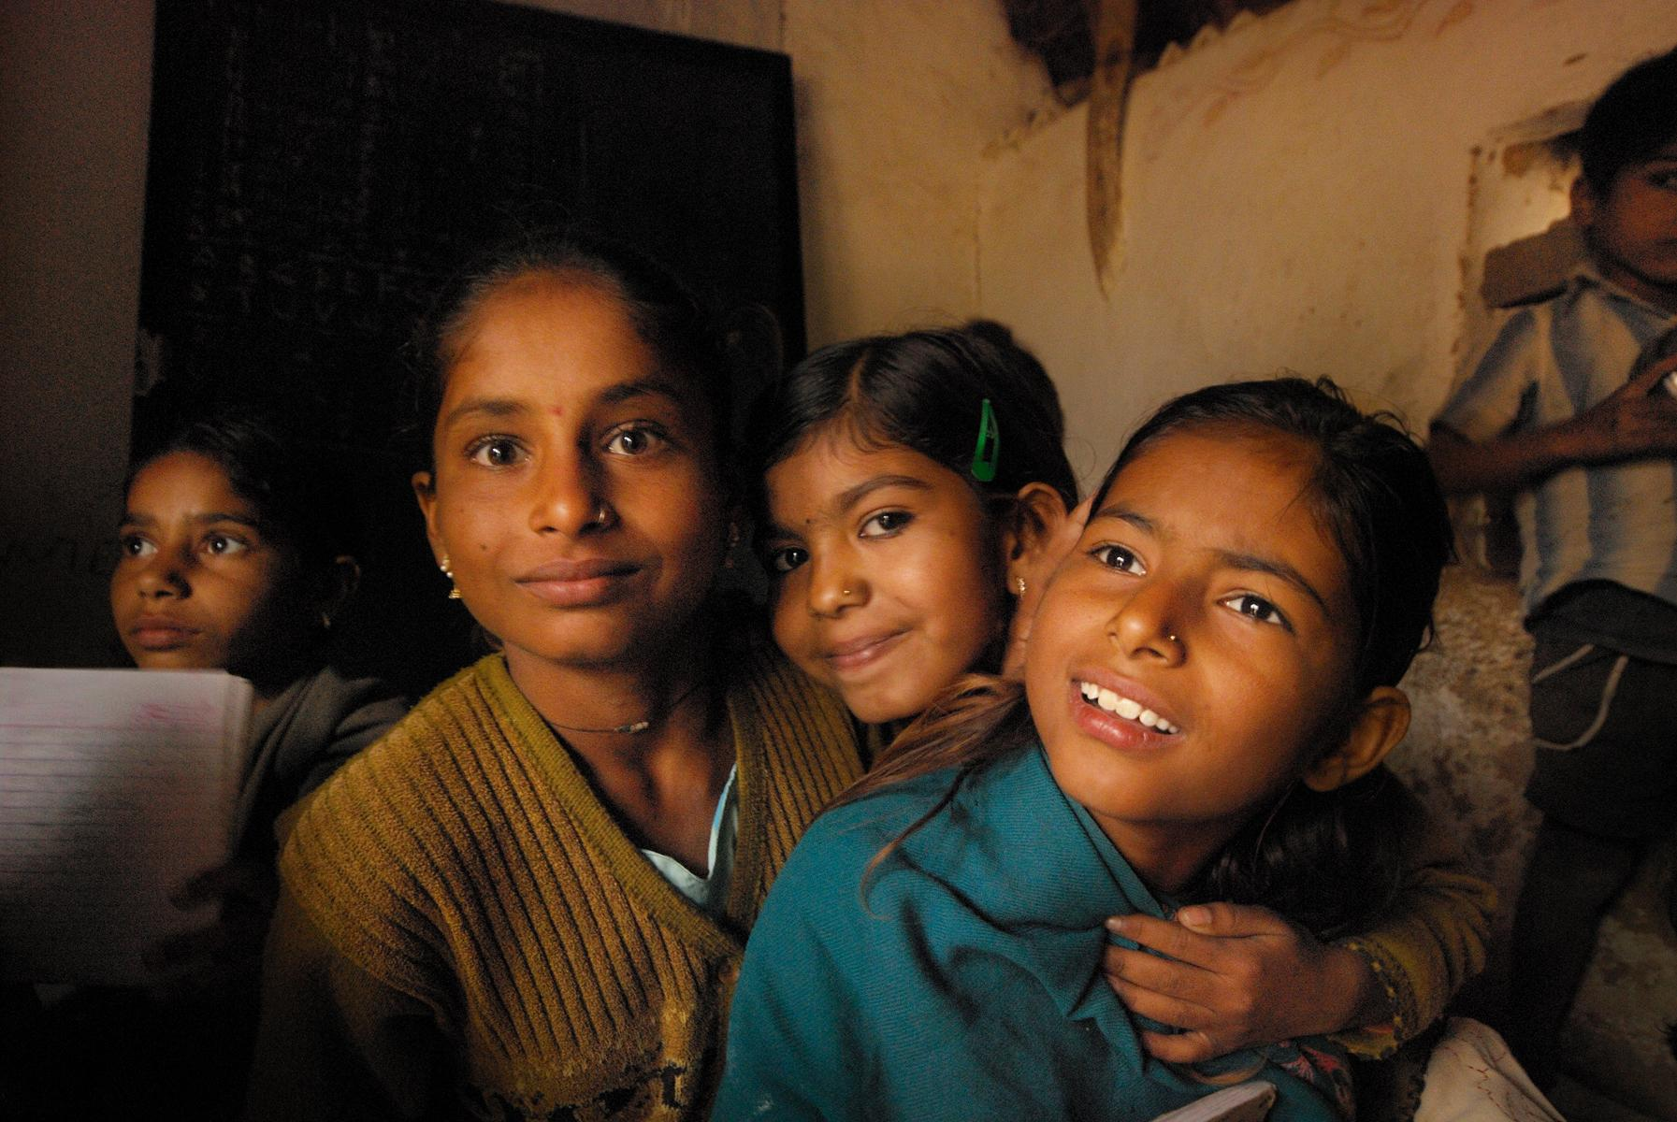
Thank You
www.geastudy.org
@geastudy

