Slide 1
Global Early Adolescent Study
December, 2018

Slide 2
Vignettes Based Measures of Gender Equality
In the Global Early Adolescent Study
The Global Early Adolescent Study: Vignettes Based Measures of Gender Equality

Slide 3
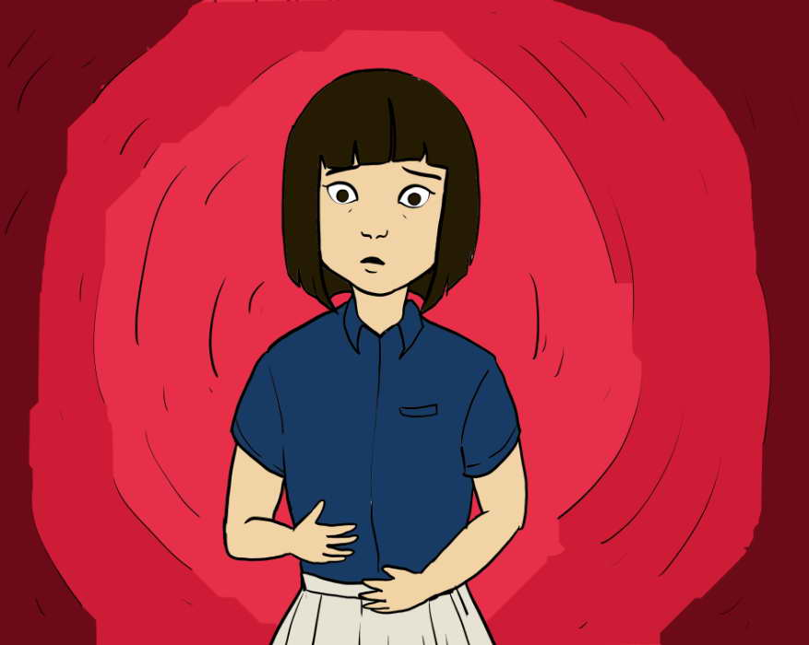
Objectives
The Vignettes-based measure of gender equality…
Assesses gender biases using stories about typical romantic and non-romantic relationships among young adolescents
Seeks to understand how young adolescents think differently about a relationship situation when it is the boy who is initiating/experiencing the situation and when it is a girl.
The Global Early Adolescent Study: Vignettes Based Measures of Gender Equality

Slide 4
How Were They Developed?
Three day focus groups
Groups of 10-12 young adolescents ages 11-14 in each site
All were mixed-sex groups
Each group
identified common situations that young adolescents find themselves in
prioritized the topics/situations
began with general discussion followed by a role play of the situation, first with a girl (or boy) in the lead then with the other sex in the lead
Researchers took notes on the storyline developed, the questions generated, and possible responses
The Global Early Adolescent Study: Vignettes Based Measures of Gender Equality

Slide 5
How Were They Developed?
Stories were compared across sites and common stories were identified
Initially, 6 cross-site prototype themes identified:
Romantic interest: boy likes girl
Freedom of movement: girl wants to go out with friends
Gender off-diagonal: girls who act more like boys
Puberty: satisfaction and embarrassment
Appropriate clothing for a young adolescent
Pregnancy
The Global Early Adolescent Study: Vignettes Based Measures of Gender Equality

Slide 6
Vignettes Measures Domains
Communication style (avoidance, indirect, direct)
Assertiveness (no, low, moderate, high)
Emotional responsiveness (very negative, negative, positive)
Social inclusion (no, some, yes)
Interaction approach (avoidance, antagonist initiates, protagonist initiates)
Responsibility (deny, low acceptance, acceptance)
The Global Early Adolescent Study: Vignettes Based Measures of Gender Equality

Slide 7
Re-Pilot: A Vignettes With One Flip
Romantic interests: boy likes girl
Gender off-diagonal: girls who act more like boys
Forced response of taking the other sex perspective
Puberty: satisfaction and embarrassment
Pregnancy
The Global Early Adolescent Study: Vignettes Based Measures of Gender Equality

Slide 8
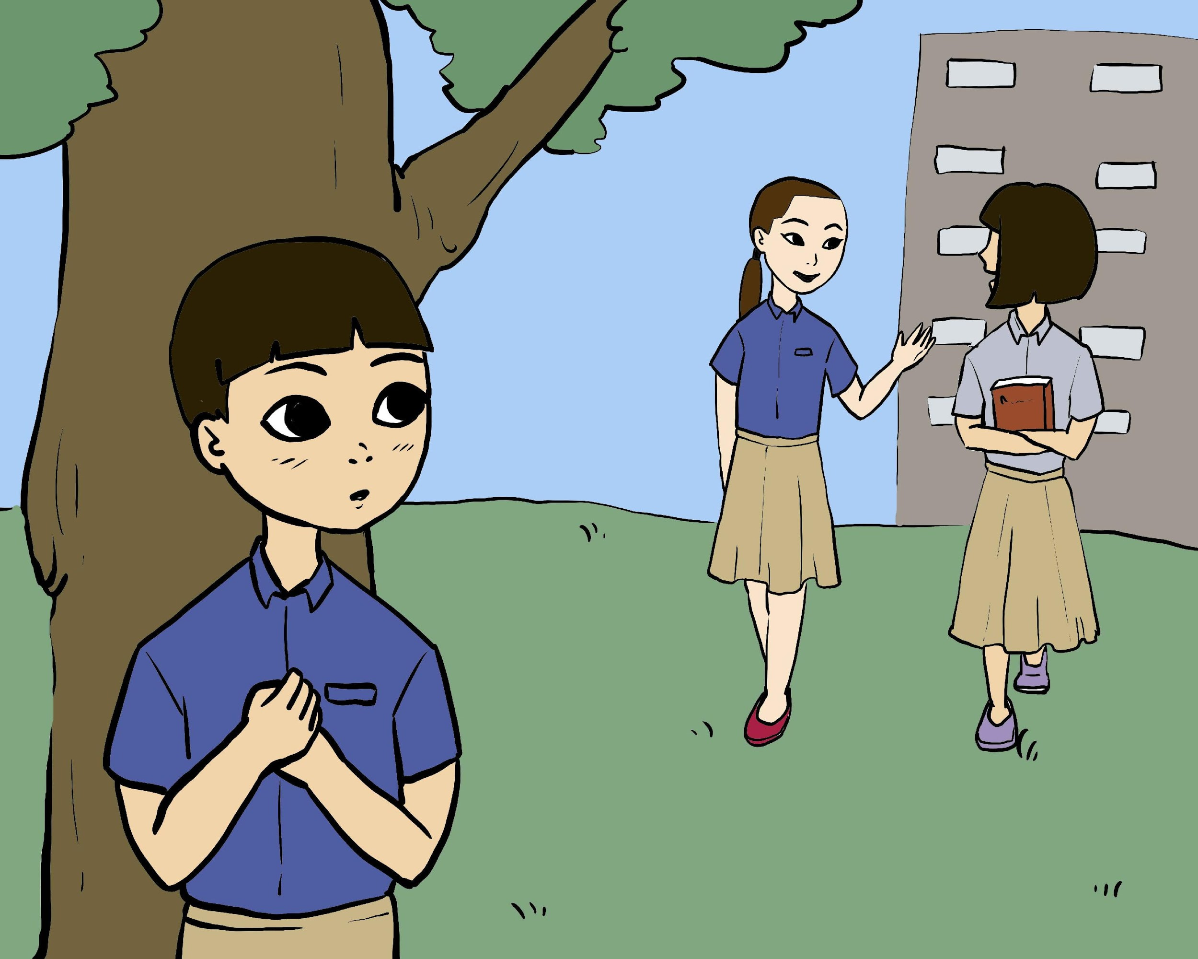
P is in 7th grade. He is attracted to A, who is in the same grade, but he doesn’t know her and has never spoken with her in person. Most of his friends have girlfriends but he has never had one before. He wants to get her attention, but is not sure how. What do you think P will do next?
Example
1 | Ask if any of the girls are going to the party | Indirect = 1
2 | Ask A directly if she is going to the party | Direct = 2
3 | Get a friend to ask A if she is going to the party | Indirect = 1
4 | Say nothing and hope that someone else will ask A if she is going | Avoidance=0
5 | Ask A’s friend if she knows if A is going to the party | Indirect=1
The Global Early Adolescent Study: Vignettes Based Measures of Gender Equality

Slide 9
Initial Pilot Respondent Differences With Male and Female Protagonists
Respondent | Protagonist Male | Protagonist Female
Boy | 1.51 | 1.53
Girl | 1.35 | 1.30
p value | p=.002 | P<.0001
The Global Early Adolescent Study: Vignettes Based Measures of Gender Equality

Slide 10
Emotional Response to Gender Atypical Peers By Sex of Respondent and Protagonist
Respondent | Protagonist male | Protagonist Female | p value
Boy | 1.64 | 0.65 | P<.001
Girl | 0.68 | 1.65 | P<.001
The Global Early Adolescent Study: Vignettes Based Measures of Gender Equality

Slide 11
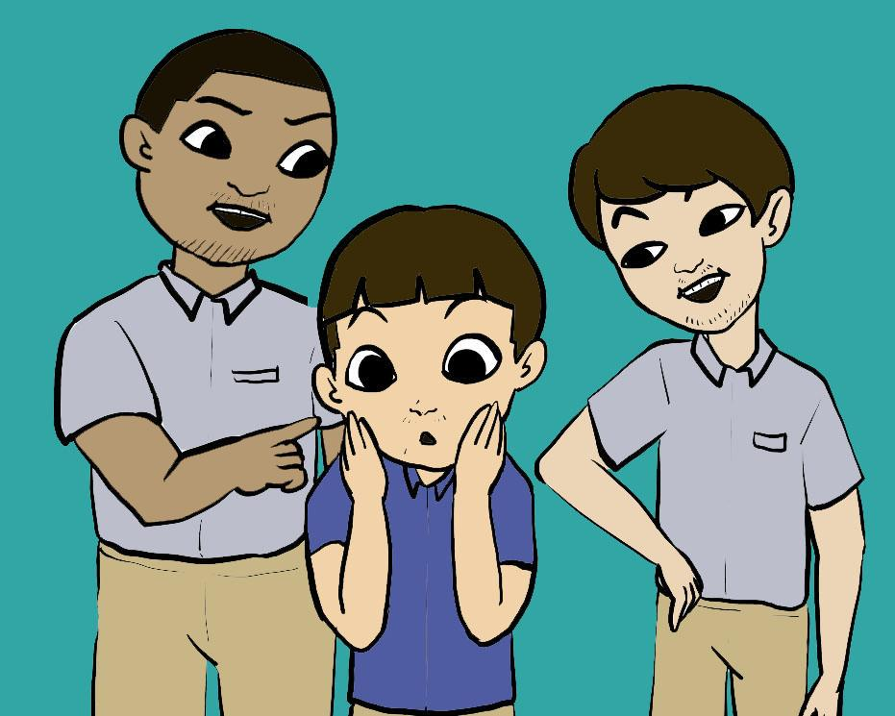
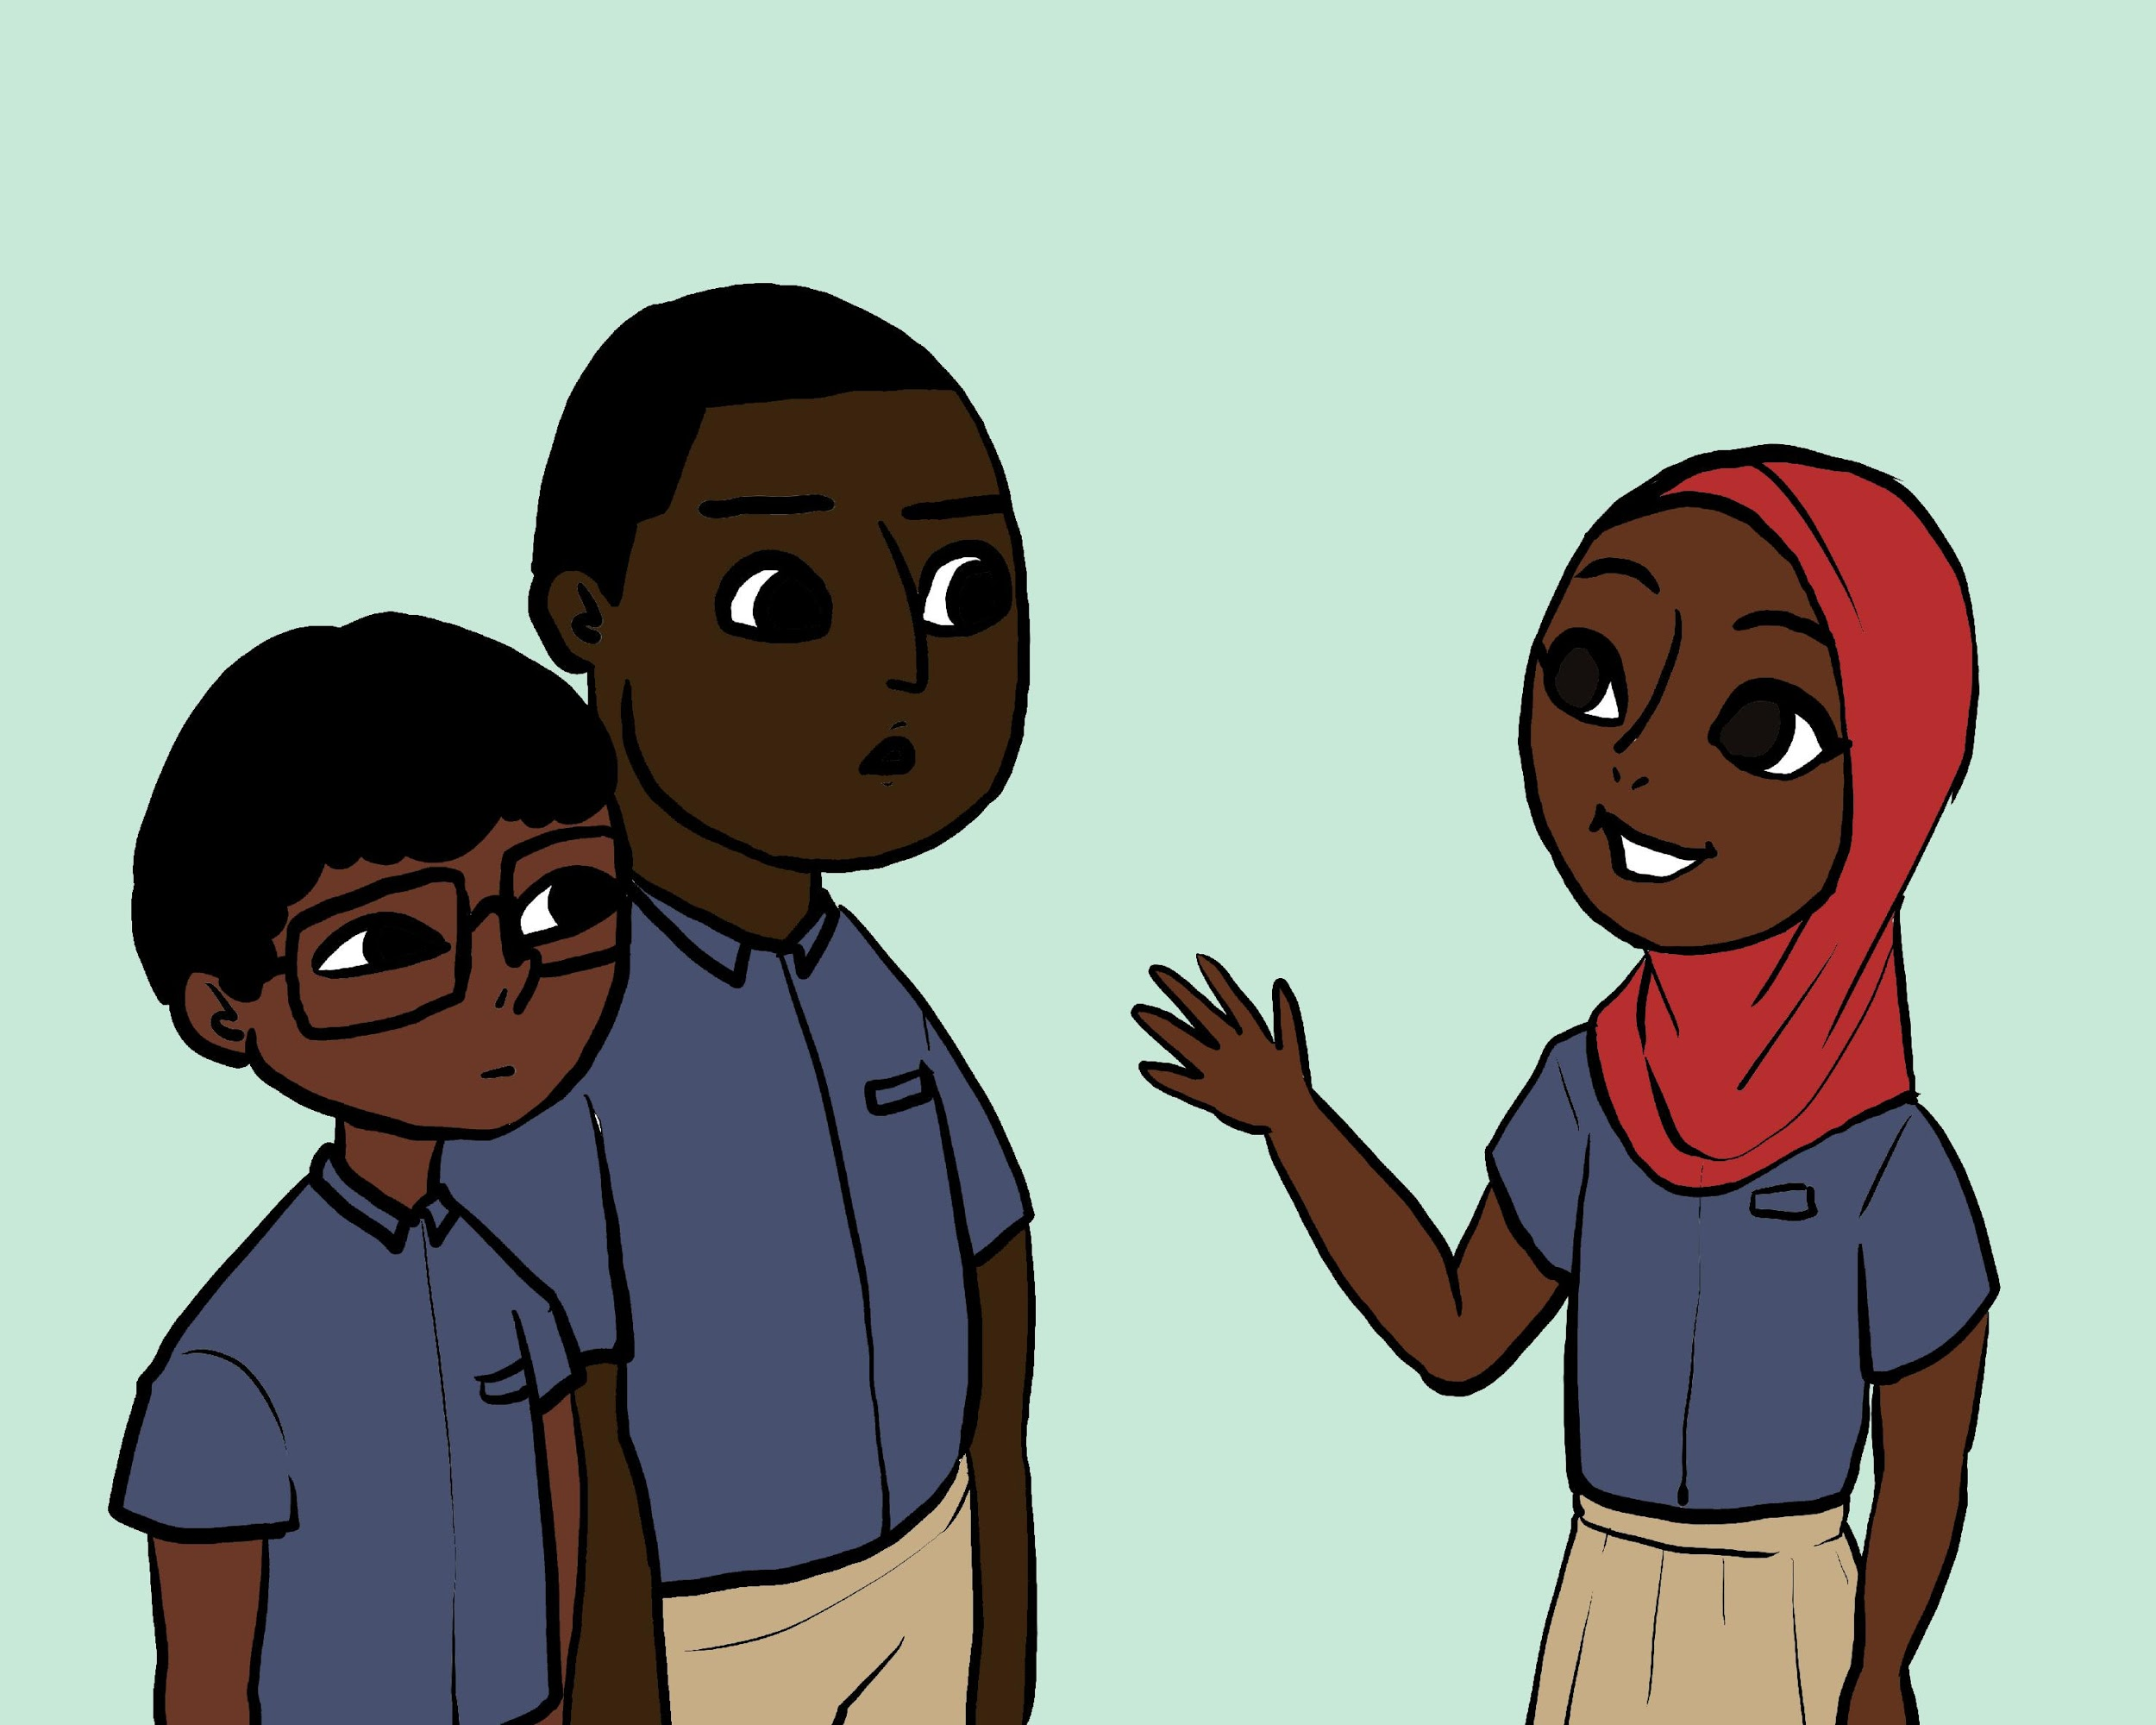
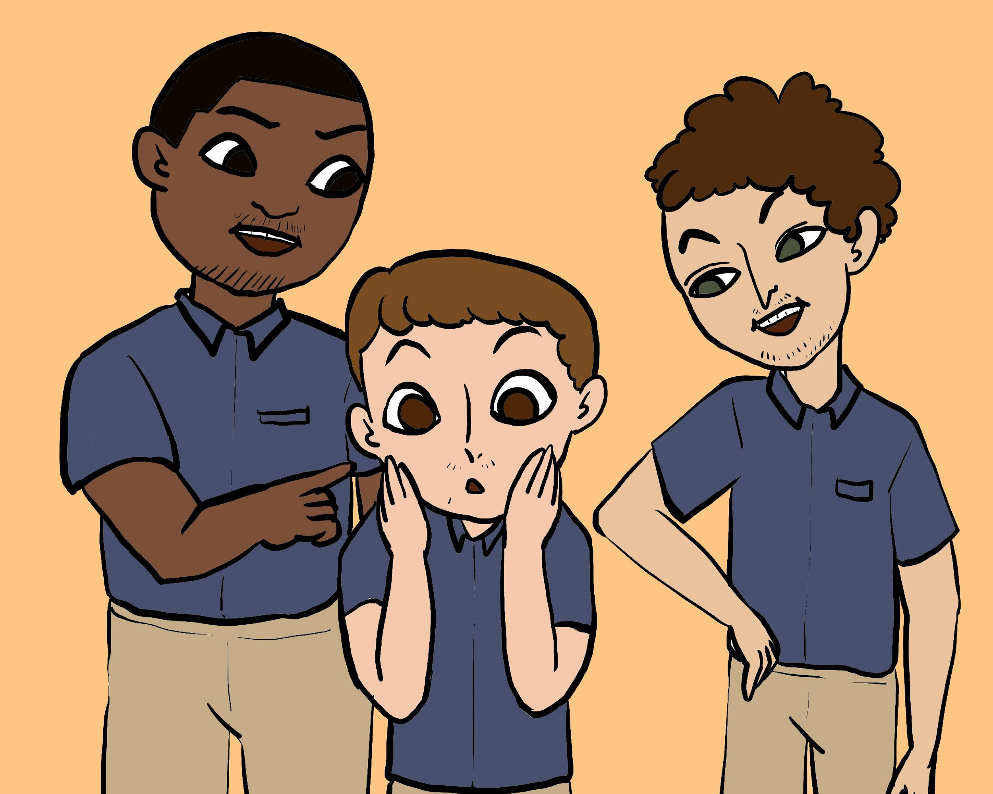
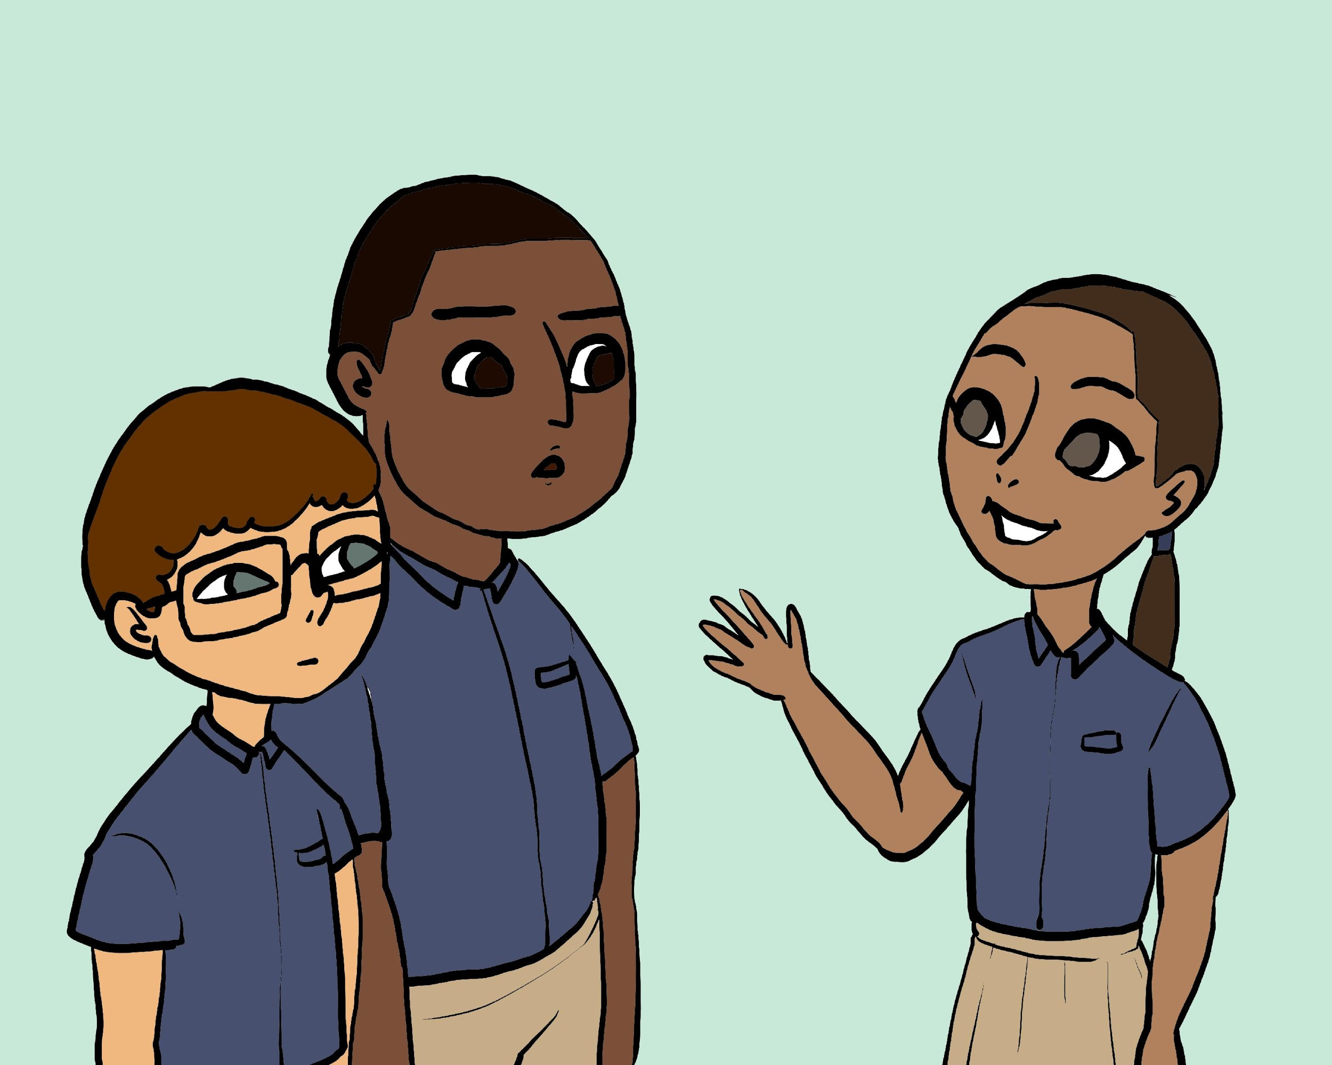
Culturally Appropriate Youth Generated Images
The Global Early Adolescent Study: Vignettes Based Measures of Gender Equality

Slide 12
Vignettes Instruments
Questionnaire with integrated vignettes (scenarios or stories) followed by questions and response options.
Designed to measure:
Gender biases using stories about typical romantic and non-romantic relationships among young adolescents.
Goal is to understand how young adolescents think differently about a relationship situation when it is the boy who is initiating/experiencing the situation and when it is a girl.
The Global Early Adolescent Study: Vignettes Based Measures of Gender Equality

Slide 13
Vignettes Instruments
Four vignettes or stories:
Liking someone in A romantic way
Teasing/ bullying
Puberty
Pregnancy
Two versions of each: the sex of the lead character changes, story remains the same
The Global Early Adolescent Study: Vignettes Based Measures of Gender Equality

Slide 14
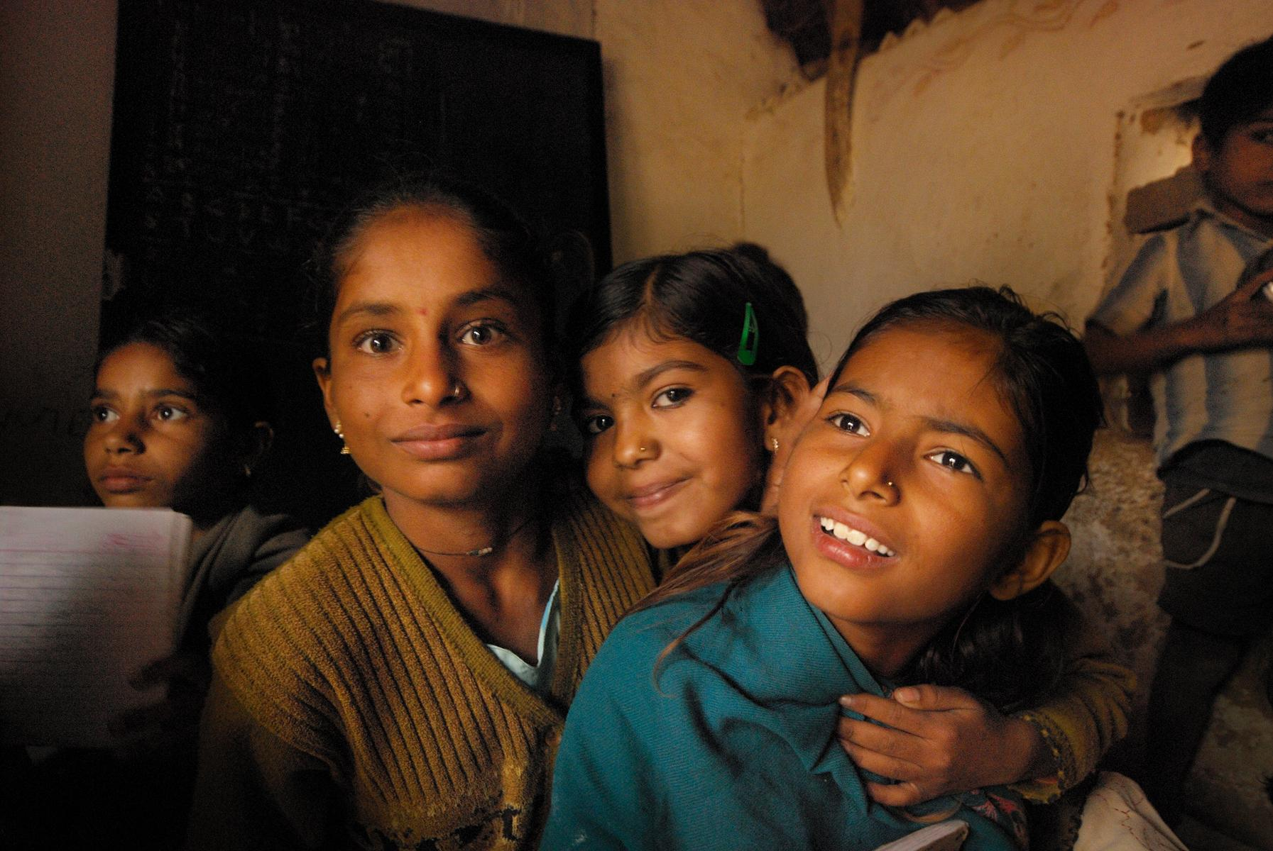
Thank You
www.geastudy.org
@geastudy

