Slide 1
What is the Global Early Adolescent Study?
GEAS Overview
1

Slide 2
The GEAS is...
The first international study that explores how gender norms evolve over time and inform a spectrum of health outcomes, including mental health and sexual and reproductive health, across the adolescent years.
GEAS Overview
2

Slide 3
Longitudinal Research Questions
1
What factors are related to gender equitable and inequitable gender norms?
How do these factors vary by site?
How do gender norms & perception of gender equality evolve over time ?
2
3
How do gender norms and perceived gender equality at the individual and community levels related to adolescent health outcomes over time? How do these influences vary by setting?
How do gender transformative interventions shift gender norms and how does this affect health trajectories for boys and girls?
4
GEAS Overview
3

Slide 4
Key GEAS Indicators Of Health & Wellbeing
GEAS Overview
4
Notes:
Mental Health (specifically depressive and anxiety symptoms)
School retention/completion
Gender-based and interpersonal violence
Healthy sexuality (i.e. body comfort)
Sexual & reproductive health

Slide 5
GEAS Formative Research
2015 - 2017
GEAS Overview
5

Slide 6
GEAS Formative Research Sites
Edinburgh,
Scotland
Ghent
Belgium
Baltimore, USA
Shanghai,
China
Assiut, Egypt
Ouagadougou, Burkina Faso
New Delhi,
India
Nairobi,
Kenya
Hanoi,
Vietnam
Cuenca,
Ecuador
Ile-Ife, Nigeria
Kinshasa, DRC
Blantyre,
Malawi
Cochabamba, Bolivia
Cape Town,
South Africa
GEAS Overview
6
Notes:
Focus in low-SES communities in urban geographies. Phase 1 involved research in 15 countries across five continents.

Slide 7
Instrument Development
Narrative interviews: 450 dyads (n=900) recorded, transcribed translated, and coded
Gender norms instrument: Narrative interviews analyzed for gender themes, organized into domains and sub-themes with questions generated for each based on youth comments
Vignettes measure of gender equality: Three day focus groups at each site, vignettes generated separately then compiled for common themes and issues
GEAS Formative Research
7
Notes:
Dyads = parent/adolescent

Slide 8
Key Takeaways
The Hegemonic Myth
There is a global set of forces
in adolescent’s environments that reinforce the hegemonic myths that:
Girls are vulnerable
Boys are strong and independent
Even in sites where parents acknowledged the vulnerability of their sons, parenting centered on protecting their daughters
Schools
Parents
Media
Peers
GEAS Formative Research
8

Slide 9
Key Takeaways
Girls are Sex Embodied
Pubertal boys are viewed as predators
Pubertal girls as potential targets and victims
Messages support the gender division of power and affect while promote sex segregation to preserve girl’s sexuality. In some places girls come to internalize these norms to even a greater extent than boys.
“Don’t sit like that
Don't wear that
Don't talk to him
Boys will ruin your future”
GEAS Formative Research
9

Slide 10
Key Takeaways
Girls Should Cover Up and Stay In
As a consequence of adult perceptions of female sexual vulnerability, in nearly every site, girls’ mobility is far more restricted than for boys.
As one girl in Assiut, Egypt noted:
“A girl cannot go out as she wishes because she is a girl and if a girl came home late her parents would shout at her, but it’s okay for a guy.”
GEAS Formative Research
10

Slide 11
Key Takeaways
Sex Segregation
There are social sanctions if they don’t
punishment
social isolation
sexual rumors
innuendo
03
Adult Concerns about Girls’ Sexual Vulnerability
01
02
Girls are told to stay away from boys
Both boys and girls lament this situation
They played together as children and were friends
Now with puberty, those friendships are no longer allowed
GEAS Formative Research
11
Notes:
Because of adult concerns about their sexual vulnerability:
girls are repeatedly told to stay away from boys
there are sanctions if they don’t
Punishment
social isolation
sexual rumor
Innuendo

Slide 12
Key Takeaways
Myth that Boys are Advantaged and Girls Disadvantaged by Gender Norms
Girls
School matriculation
Younger/child marriage
GBV
Depression and suicidality
Boys
Interpersonal violence & homicide
Early school leaving
Suicidality
Vehicular injury
Tobacco, alcohol & substance use
Lower life expectancy
The reality is that both boys and girls are disadvantaged by inequitable gender norms.
GEAS Formative Research
12
Notes:
boys - early school leaving (increasingly at rates greater than girls)

Slide 13
Key Takeaways
Gender Norms
There are common social norms regulating gender relations in early adolescence
Gender norms are inter-relational
Normative expectations consistent within and across sites
Discordant norms for girls: sexual double standard and normative expectations about romantic relations
Next steps
Cross-site and longitudinal analyses of gender norms scales
Test of associations with gender based violence, sexual health and mental health indicators
GEAS Instruments
13
Notes:
Narrative interviews analyzed for gender themes, organized into domains and sub-themes with questions generated for each based on youth comments

Slide 14
Products
Systematic Review of Gender Norms Literature in Early Adolescence
Qualitative findings on transitions into adolescence
Developed and validated quantitative measures of gender norms & health
Gender norms scales
Vignettes-based measure of gender equality in relationships
Health instrument with 10 modules including mental health, adverse childhood experiences, violence and empowerment
Parent/guardian questionnaire
GEAS Overview
14

Slide 15
GEAS Instruments
GEAS Instruments
15

Slide 16
Gender Norms
Scales
Scale with statements and multiple response options
Designed to:
Measure young adolescents’ perceptions, attitudes or beliefs about gender norms (i.e. about masculinities and femininities)
Identify common gender norms across different cultural settings.
GEAS Instruments
16

Slide 17
Gender Norms
Sexual Double Standard
•Adolescent boys fool girls into having sex
•Boys tell girls they love them when they don't
•Adolescent boys lose interest in a girl after they have sex with her
•Adolescent girls should avoid boys because they trick them into having sex
•Boys have girlfriends to show off to their friends
•Boys have girlfriends for fun more than love
•Boys feel they should have girlfriends because their friends do
•A girl will lose interest in studying if she has a boyfriend
•Girls who have boyfriends are irresponsible
GEAS Instruments
17
Notes:
SDS measures the extent to which women and men, or boys and girls are held to different standards of sexual conduct. In the GEAS we measure this phenomenon with a scale comprised of the following items.

Slide 18
Gender Norms
Adolescent Expectations about Relationships
•A girl should be able to have a boyfriend if she wants to
•A boy and a girl your age should be able to spend time together if they want to
•A boy should be able to have a girlfriend if he want to
•It's normal for a boy your age to want a girlfriend
•It's normal for a girl to want a boyfriend at your age
GEAS Instruments
18
Notes:
ARE measures the extent to which adolescents find romantic relationships between girls and boys at their age normal.

Slide 19
Gender Norms
Gender Stereotypical Traits
•Boys should be raised tough so they can overcome any difficulty in life.
•Girls should avoid raising their voice to be lady like.
•Boys should always defend themselves even if it means fighting.
•Girls are expected to be humble.
•Girls need their parents protection more than boys.
•Boys should be able to show their feelings without fear of being teased.
•Boys who behave like girls are considered weak.
•It's important for boys to show they are tough even if they are nervous inside
GEAS Instruments
19
Notes:
ARE measures the extent to which adolescents find romantic relationships between girls and boys at their age normal.

Slide 20
Gender Norms
Gender Stereotypical Roles
•A boy should always have the final say about decisions with his girlfriend
•It is okay to tease a girl who acts like a boy.
•It is okay to tease a boy who acts like a girl.
•Boys and girls should be equally responsible for household chores.
•A woman’s role is taking care of her home and family.
•A man should have the final word about decisions in the home.
•A woman should obey her husband in all matters.
•Men should be the ones who bring money home for the family, not women.
GEAS Instruments
20
Notes:
ARE measures the extent to which adolescents find romantic relationships between girls and boys at their age normal.

Slide 21
Empowerment
GEAS Definition
Empowerment as both a goal & process for achieving health outcomes
Why early adolescence?
Life course perspective
Role of adolescent empowerment in shaping downstream health outcomes
No existing empowerment measures for this age group
Address elements relevant to everyday lives of adolescents
Cross-cultural
“The process of enhancing an individual‘s or group‘s capacity to make effective choices, that is, to make choices and then to transform those choices into desired actions and outcomes”
-World Bank
GEAS Instruments
GEAS Instruments
21
Notes:
Empowerment is increasingly recognized as both a human right in and of itself and a means towards improved outcomes, including economic and health outcomes. However, though empowerment is recognized as a process that evolves across the life course, little is known about the manifestations of empowerment among young adolescents or in its relationship to sexual and reproductive health outcomes during early adolescence, a critical period shaping reproductive health trajectories.
To our knowledge, no existing instruments have been created specifically to measure empowerment among this age group. The Global Early Adolescent Study therefore developed and piloted empowerment measures tailored to the lives of young adolescents, for whom transposition of empowerment measures created for adults likely would not be relevant. These cross-cultural measures were developed and pilot tested across 15 countries, and re-piloted in 6.
The GEAS definition of empowerment reflects the World Bank’s definition, wherein empowerment is a process that enhances one’s ability to make effective choices.

Slide 22
Empowerment
GEAS Framework
Opportunity Structures
Achievement of desired outcomes
Political Cultural Legal
Family Economic Education Social Capital
Agency
Freedom of Movement
● Ability to move autonomously within the environment
Voice
● Ability to express opinions and be heard
● Ability to express needs and desires
Decision-Making
● Ability to make decisions that govern daily life
GEAS Instruments
22
Notes:
The GEAS conceptual framework nests agency, as measured by freedom of movement, voice, and decision-making, within opportunity structures of an adolescent's socio-ecological environment. Together, agency operates within an adolescent’s opportunity structure to shape achievement of desired outcomes.

Slide 23
Empowerment
4 Dimensions
Voice
“I can speak up in class when I have a comment or question”
“I can ask adults for help when I need it”
Freedom of Movement
Can you tell me how often you are allowed to do the following without an adult…
“Go to a party with both boys and girls”
“Go to church/mosque/temple/religious center”
GEAS Instruments
23
Notes:
First evidence that empowerment as a concept can be evaluated amongst 10-14 adolescents
Some aspects of empowerment appear to be universal
Further investigation will examine whether empowerment is associated with outcomes

Slide 24
Empowerment
4 Dimensions (cont’d)
Decision making
How often are you able to make the following decisions on your own, without an adult?
“What clothes to wear when you are not in school/working”
”Who you can have as friends”
Economic
In the past year have you done any activities to earn money?
Do you make the decision whether or not to work?
GEAS Instruments
24
Notes:
First evidence that empowerment as a concept can be evaluated amongst 10-14 adolescents
Some aspects of empowerment appear to be universal
Further investigation will examine whether empowerment is associated with outcomes

Slide 25
Vignettes-Based Measures of Gender Equality Development
3-day focus groups with mixed-sex groups
10-12 young adolescents 11-14 years old
Groups prioritized the topics/situations common to VYA
Groups began with general discussion followed by a role play of the situation, first with a girl (or boy) in the lead then with the other sex in the lead
Researchers took notes on the storyline developed, the questions generated, and possible responses
Stories were compared across sites and common stories were identified
Initially, 6 cross-site themes identified then narrowed to 4 after piloting
GEAS Instruments
25

Slide 26
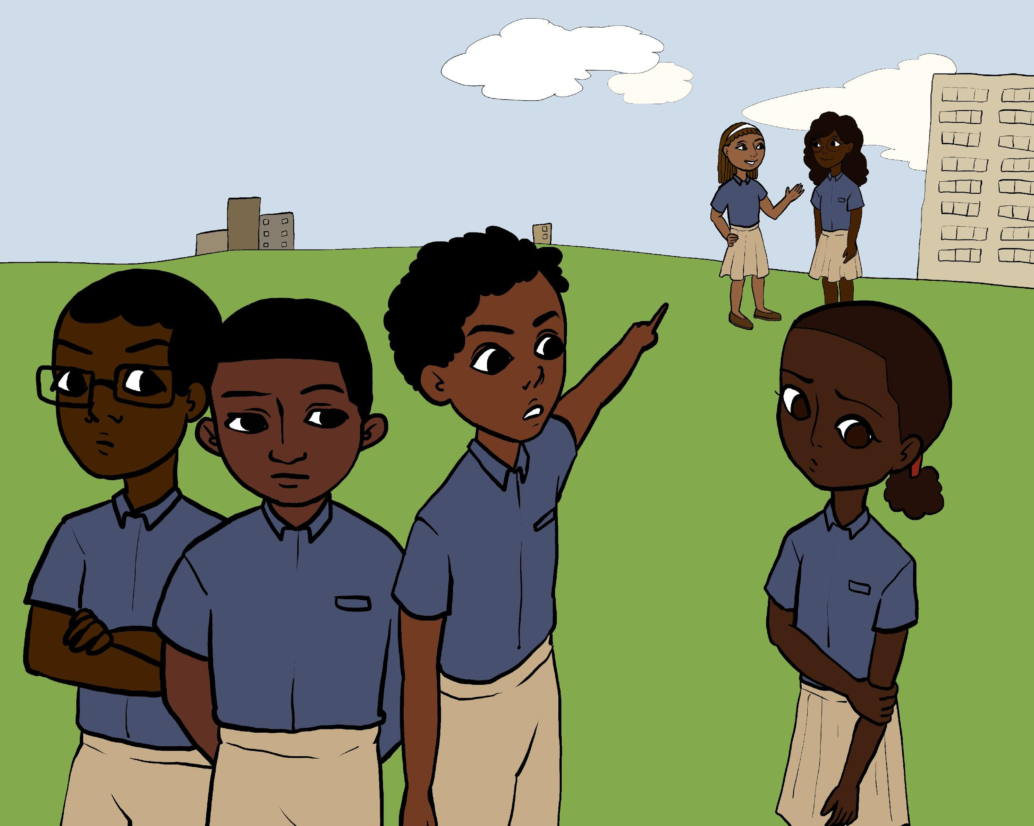
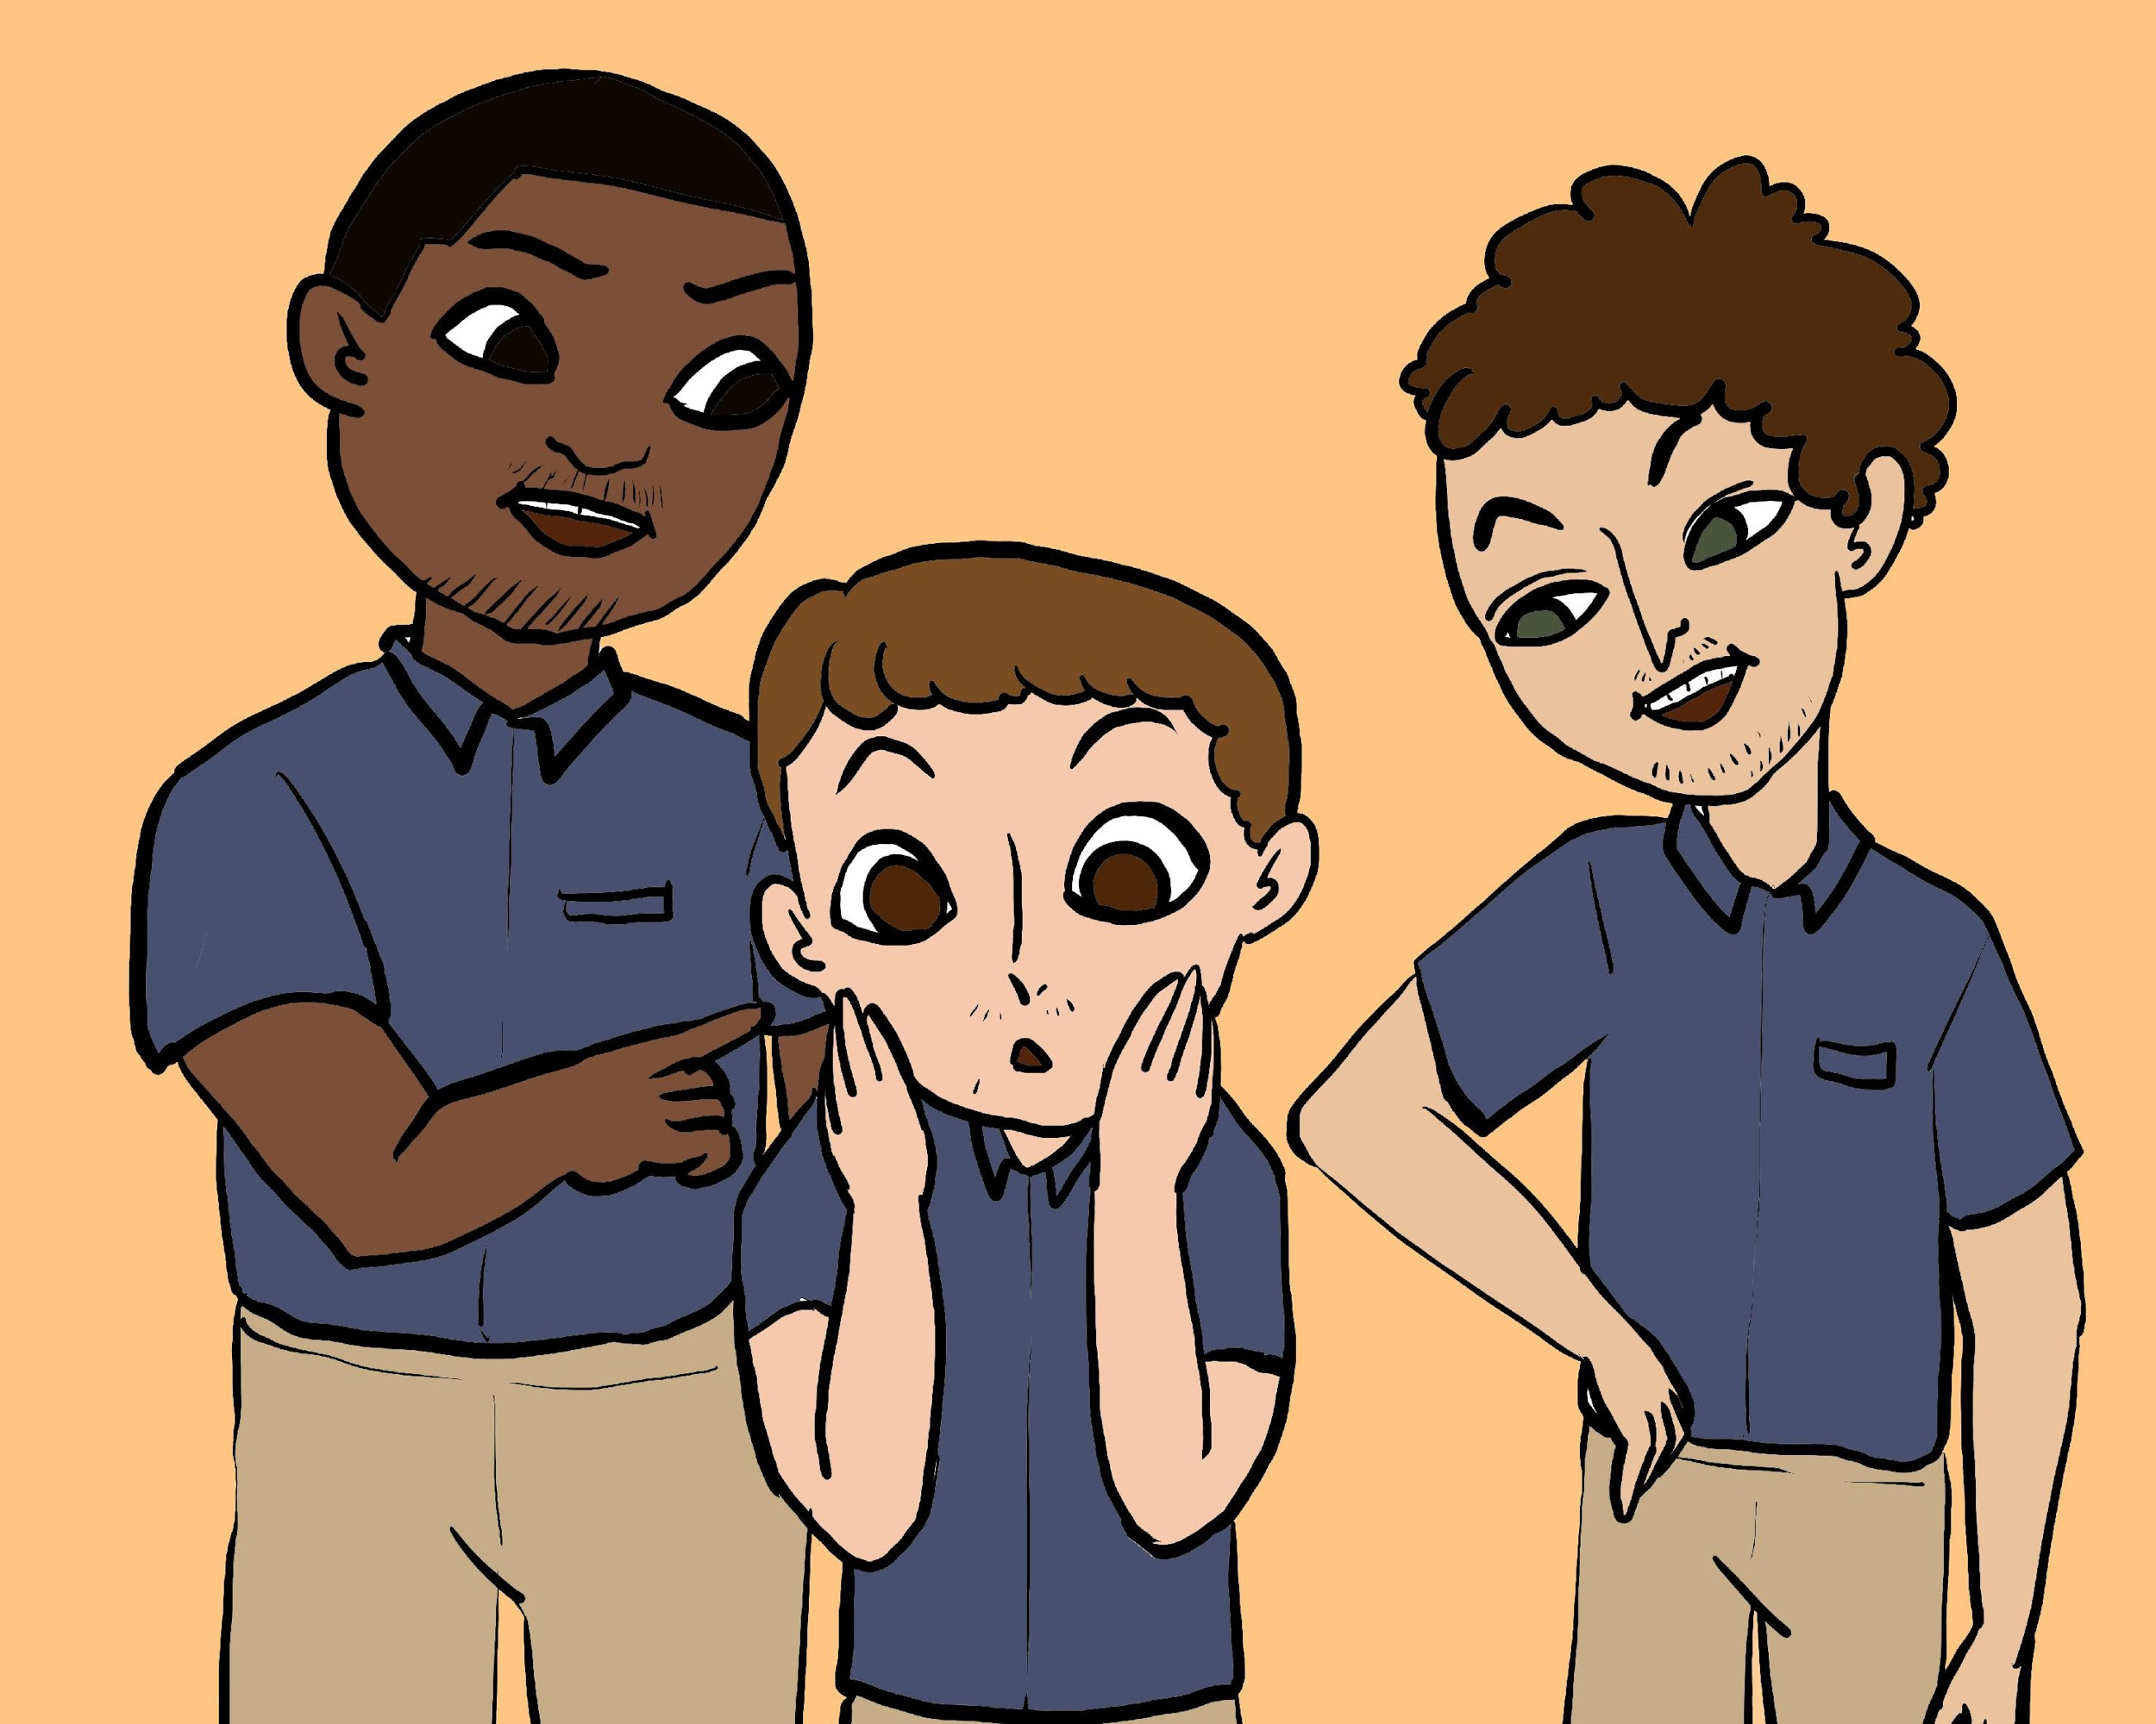
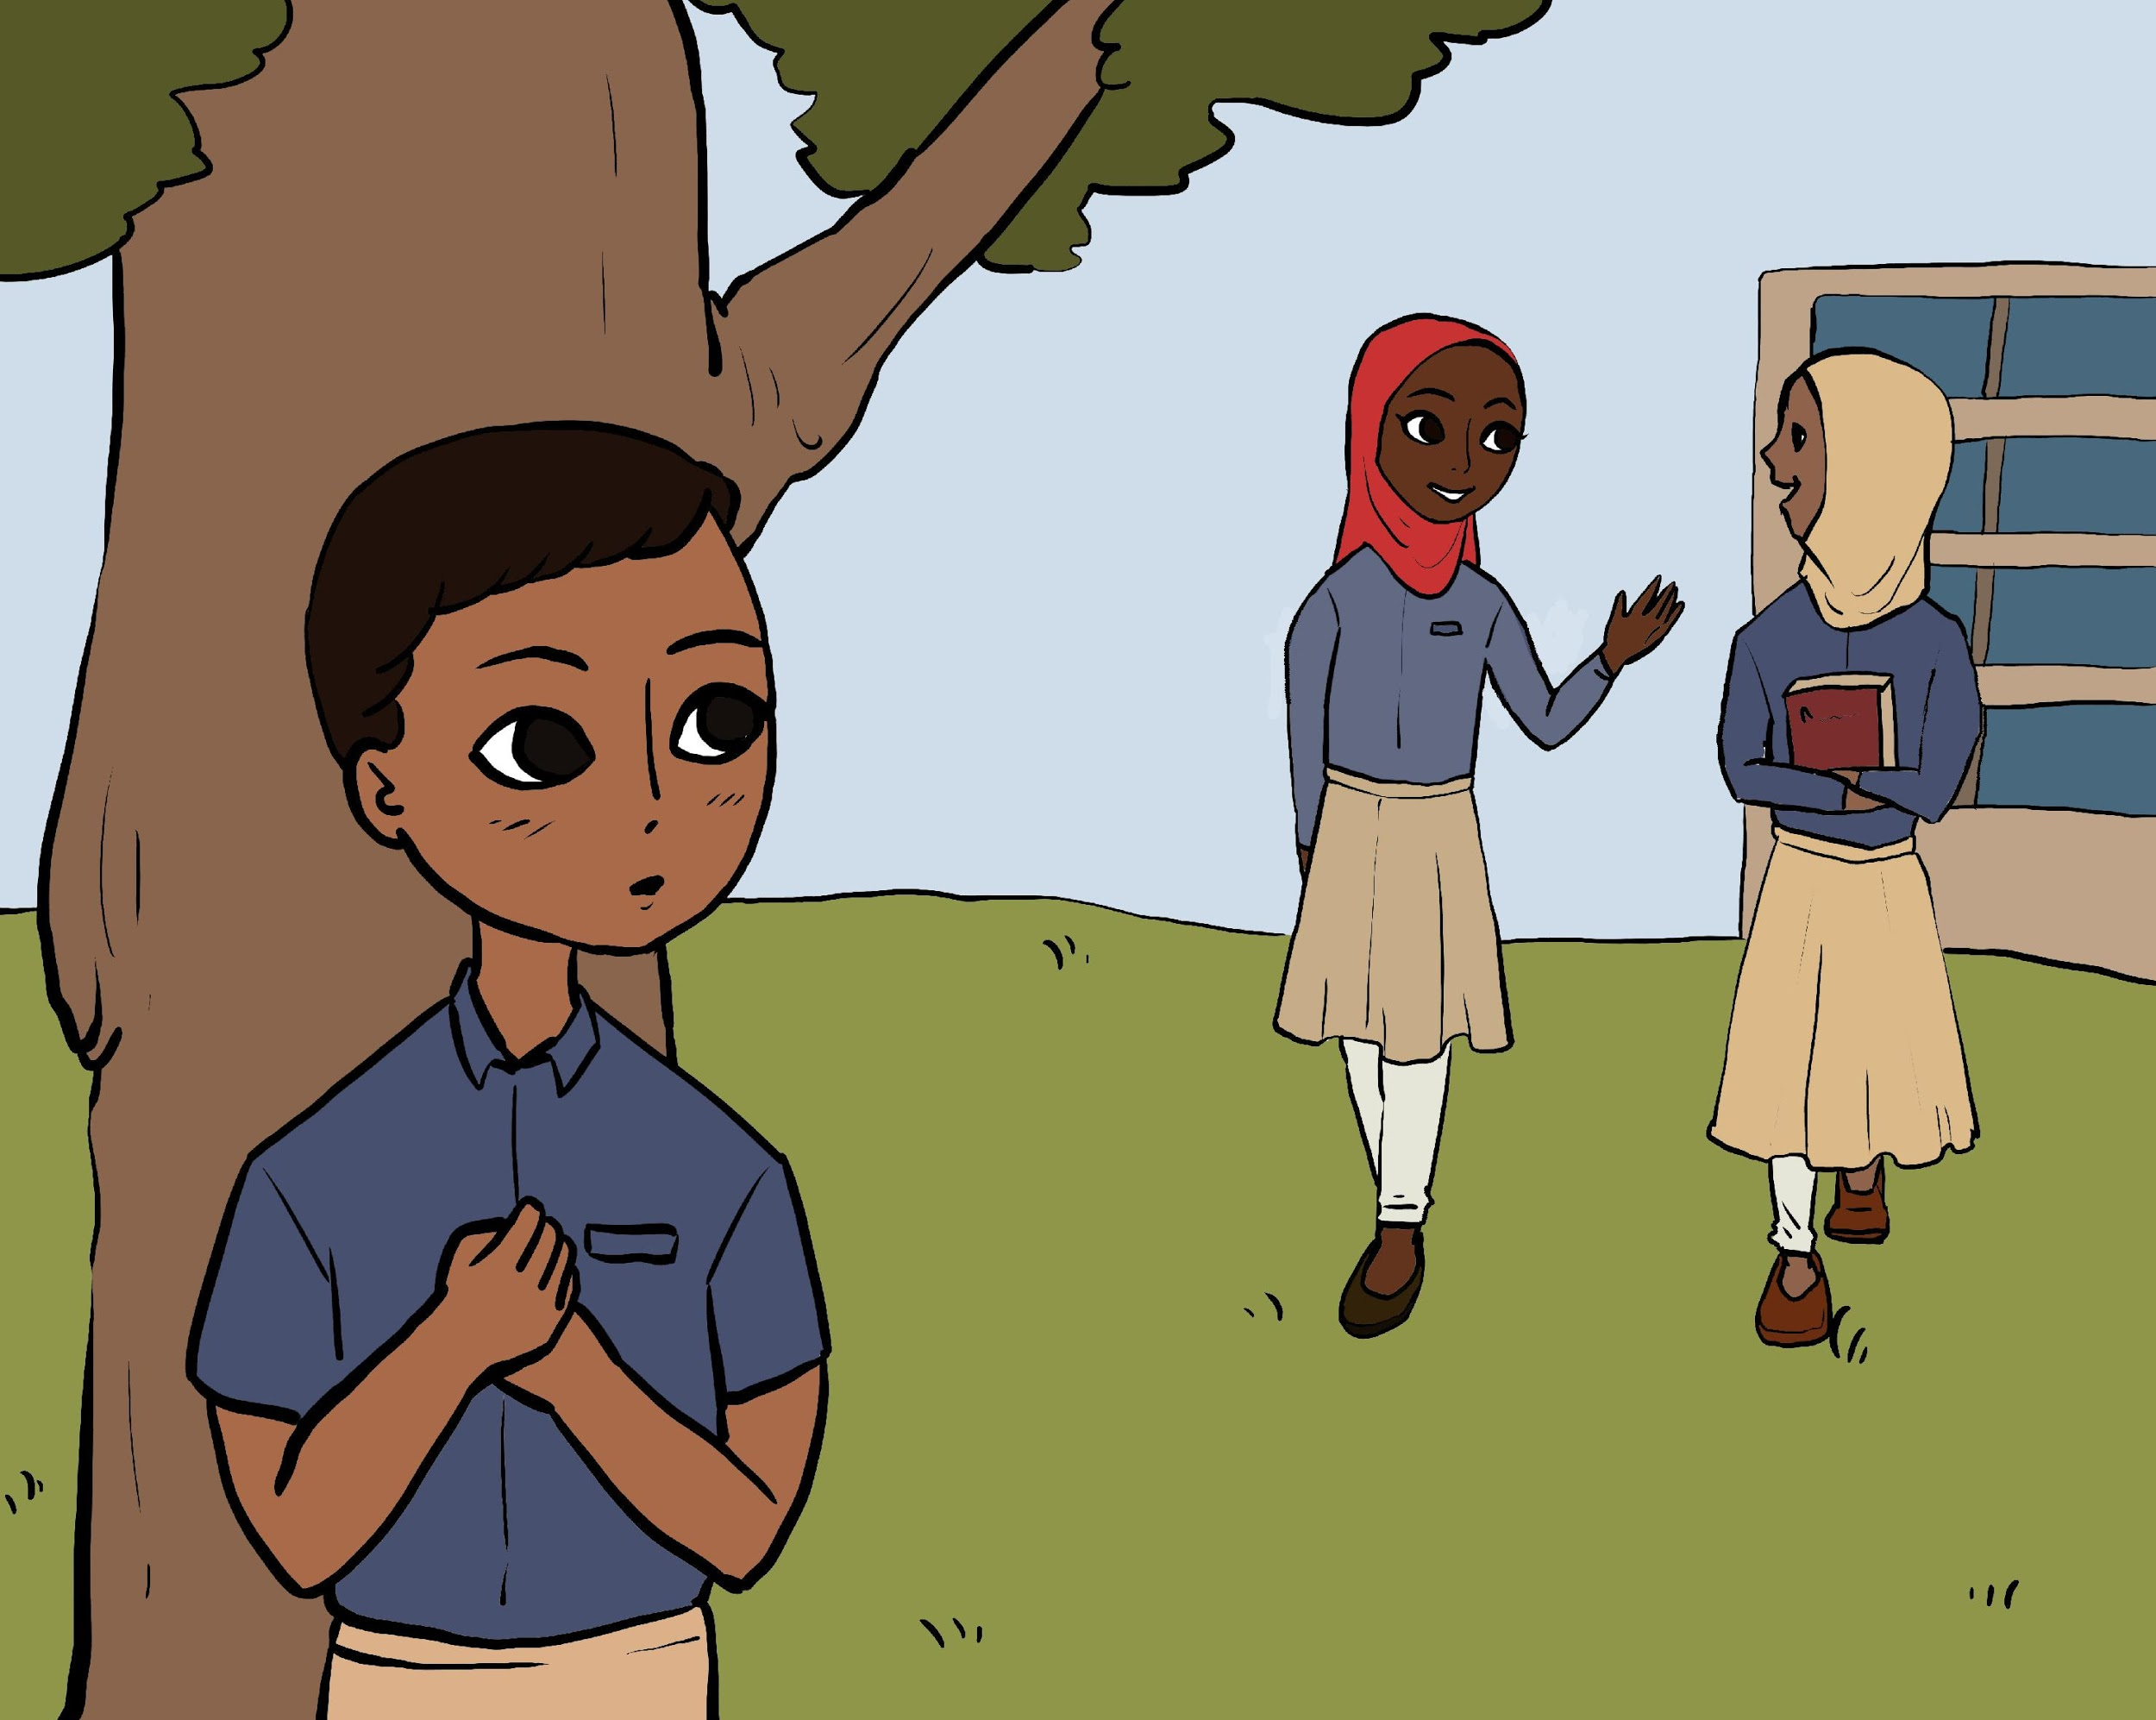
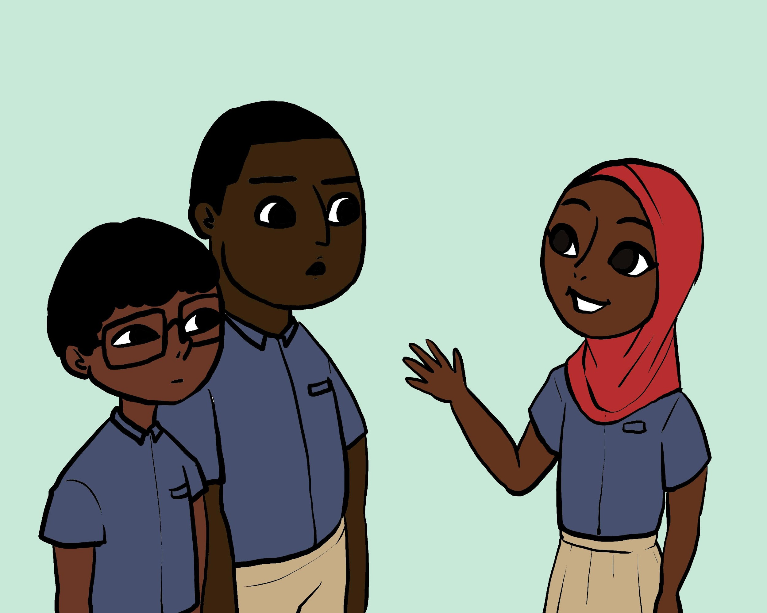
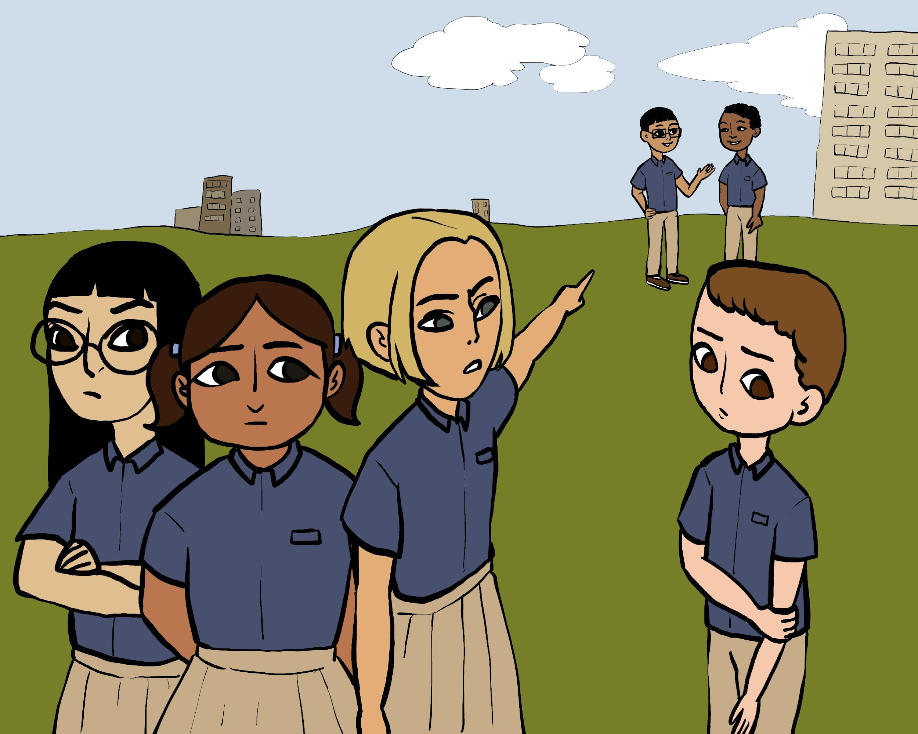
Vignettes-Based Measure of Gender Equality
Storyline Images
GEAS Instruments
26
Notes:
The vignettes storylines are accompanied by context-specific images to depict these social situations

Slide 27
Vignettes-Based Measure of Gender Equality
Storyline Themes
1
Romantic Interest
A boy likes a girl | a girl likes a boy
Gender off-diagonal
Girls who act more like boys | boys who act more like girls
2
3
Puberty
Satisfaction and embarrassment
Pregnancy
Reaction and responsibility
4
GEAS Instruments
27
Notes:
1 - communication style, assertiveness,
2 - measures social inclusion, emotional response
3 - communication style, interaction style, emotional response
4 - Responsibility for pregnancy, emotional response

Slide 28
VIGNETTES
MEASURE DOMAINS
01
Communication Style
Avoidance
Indirect
Direct
02
Assertiveness
No
Low
Moderate
High
03
Emotional Responsiveness
Very negative
Negative
Positive
04
Social Inclusion
No
Some
Yes
05
Communication Style
Avoidance
Indirect
Direct
06
Interaction Approach
Avoidance
Antagonist Initiates
Protagonist Initiates
07
Responsibility
Deny
Low acceptance
Acceptance
GEAS Overview
28
Notes:
Communication style (avoidance, indirect, direct)
Assertiveness (no, low, moderate, high)
Emotional responsiveness (very negative, negative, positive)
Social inclusion (no, some, yes)
Interaction approach (avoidance, antagonist initiates, protagonist initiates)
Responsibility (deny, low acceptance, acceptance)

Slide 29
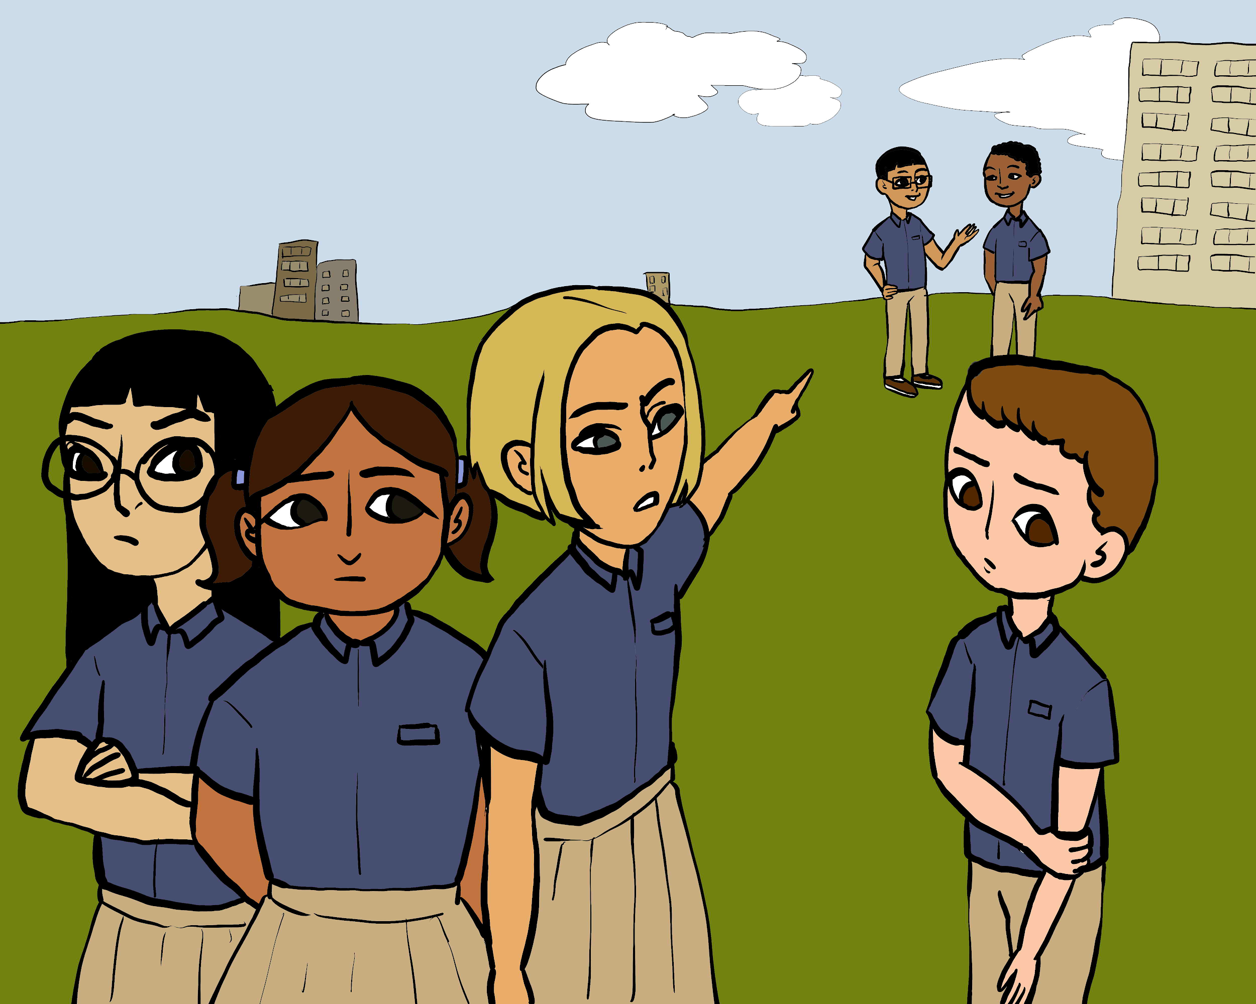
G is in your grade.
She is attracted to L who is in the same grade, but she doesn’t know him and has never spoken with him.
Many of her friends say they have boyfriends but she has never had one before.
She wants to get L’s attention, but is not sure how.
What do you think she would do to get his attention?
Pick the best option among the following:
Vignettes-Based Measure of Gender Equality
Example
Ask a friend to tell L that she likes him
Pass L a note
Go up and talk to L directly
Nothing, just wait, hoping she will meet L
Indirect
Direct
Direct
Avoidance
GEAS Instruments
29

Slide 30
Adverse Childhood Experiences
Background
Felitti et. al.(1998) found a strong relationship between exposures to adversity in childhood and adult morbidity
Initial study: n=~14,000 adults, middle-high income clinic
Seven categories:
25% had experienced 2 or more ACES
There was a graded response that showed as the number of exposures increased so too did a wide array of adult acute and chronic disease:
Violence against mother
Familial substance abuse
Familial mental illness or suicidality
Familial incarceration
Psychological abuse
Physical abuse
Sexual abuse
Ischemic heart disease
Cancer
Chronic lung disease
Skeletal fractures
Liver disease
GEAS Instruments
30

Slide 31
Adverse Childhood Experiences
Maltreatment Items
Fear of being physically abused | Have you ever been scared that your parents or other adults were going to hurt you badly (so that you were injured or killed)?
Fear of being emotionally abused | Have you ever been scared or felt really bad because grown-ups called you names, said mean things to you, or said they did not want you?
Emotional Neglect | Have you ever felt like you are not loved or cared about?
 | Have you ever felt like you have no one that protects you?
Physical Neglect | Has there ever been a time of your life when you were totally on your own and had to take care of yourself for more than a short time?
Sexual Abuse | Has an adult ever touched you in your private parts except when being bathed?
 | Has an adult ever attempted or forced you to have sexual intercourse?
GEAS Instruments
31
Notes:
(4-PT LIKERT SCALE) Range from Never – Often

Slide 32
Adverse Childhood Experiences
Household Exposure Items
Substance Abuse | Have your parents/guardian ever drank too much alcohol or used drugs so they came home and were really abusive to you or your family?
Incarceration | Have any of your parents ever been in prison/jail?
Anxiety or depression | Have you ever seen your mother or father so sad that they couldn't take care of you?
Witness Domestic Violence | Have you ever seen your mom being hit, beaten or threatened?
Household instability | Has there ever been a time when your family did not have enough food because they had no money?
 | Has your family ever been forced to leave your home/house?
GEAS Overview
32
Notes:
(4-PT LIKERT SCALE) Range from Never – Often

Slide 33
Adverse Childhood Experiences
Key Takeaways
There is substantial exposure to adversity by many young people in low income settings around the world
These exposures raise a complex set of ethical issues
The implications of ACES exposures for adolescents and adults in low and middle income countries has yet to be determined.
This is the first world-wide study of 10-14 year olds that includes a measure of ACES
GEAS Instruments
33

Slide 34
Longitudinal Research
GEAS Instruments
34

Slide 35
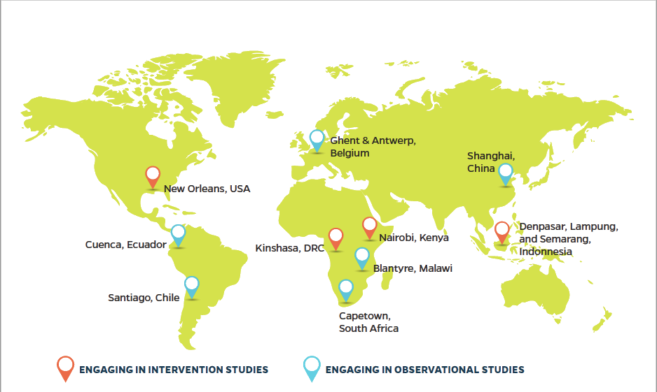
Longitudinal Research
Sites
GEAS Overview
35
Notes:
2 types of sites:
a. Longitudinal research sites following a cohort of young adolescents over time to explore the research questions noted below;
b. Intervention research sites where the GEAS is used to evaluate intervention impact. Control group samples in the intervention will also allow for comparisons with longitudinal research sites.

Slide 36
Longitudinal Research
Questions
1
What factors are related to gender equitable and inequitable gender norms?
How do these factors vary by site?
How do gender norms & perception of gender equality evolve over time ?
2
3
How do gender norms and perceived gender equality at the individual and community levels related to adolescent health outcomes over time? How do these influences vary by setting?
How do gender transformative interventions shift gender norms and how does this affect health trajectories for boys and girls?
4
GEAS Overview
36

Slide 37
PHASE 2 INTERVENTION RESEARCH QUESTIONS
The extent to which gender transformative interventions:
Are protective against:
gender-based violence
interpersonal violence
depression
Promote:
School retention
Body comfort and satisfaction
Healthy sexual and reproductive health behavior

Slide 38
Longitudinal Research
Study Design
1,400 Adolescents in each site
10-14 years old - - - 15-19 years old
3-5 years, ~3 waves of data collection
Sampling
Predominantly urban poor based on geographic residence
Recruitment:
School based sample of adolescents
GEAS Overview
GEAS Overview
38
38
Notes:
Longitudinal cohort survey of 1,400 adolescents

Slide 39
Longitudinal Research
Follow-up Surveys
Participants can withdraw at any time
Attrition
Strategies will be used to follow up with participants over time (more on this later!)
ID Cards
Tracking Forms
Site sample calculations account for up to 40% attrition over time
Surveys are adapted for follow-up to reduce survey burden and facilitate longitudinal data collection
GEAS Overview
39
Notes:
Follow-up surveys only for adolescent participants

Slide 40
Longitudinal Research
Inclusion & Exclusion Criteria
Inclusion Criteria | Exclusion Criteria
10 – 14 years old | Not 10 – 14 years old
Live with parent/guardian | Not living with parent/guardian
Attend a school participating in the study | Not enrolled in a school participating in the study
Adolescent provided assent | Adolescent did not provide assent
Parent consented | Parent did not consent
GEAS Overview
40

Slide 41
Longitudinal Research
How is Data Collected?
 | Adolescent Survey | Parental Survey
How long? | 1.5 hours, 12 modules | 20-30 minutes
How? | In person with tablets (self-interview with or without interviewer, or self-interview with audio) | With tablets (self-interview or with an interviewer)
When? | After parental consent is obtained | Usually at the time of parental consent
Where? | School or extracurricular settings | At school, over the phone, at home
GEAS Overview
41
Notes:
Interview modalities depend on the context where data collection takes place, literacy levels, and sensitivity of survey questions

Slide 42
Longitudinal Research
Ethical Approval
Johns Hopkins Bloomberg School of Public Health
Institutional Review Board
Secondary Data Analysis Exemption
Local IRB Approval for Each Site
GEAS Overview
42

Slide 43
Longitudinal Research
Tablet-Based Data Collection
Central Server: Data Aggregation & Database
Data validation & analyses
Data management
Data transfer via GPRS networks
interface for external data access:, GEAS network
Near real-time update
CASI & ACASI testing
Mobile Data collection
Supervisor
Interviewer
Adolescent Respondents
GEAS Overview
43
Notes:
Update

