Slide 1
Global Early Adolescent Study
December, 2018

Slide 2
Health Instruments
In the Global Early Adolescent Study
The Global Early Adolescent Study: Health Instruments

Slide 3
Health Instruments
Questionnaire with questions and close-ended response options
Designed to measure:
Healthy sexuality and sexual health as young people initiate sexual behaviors.
Empowerment, self-perceived health (mental, physical), gender-based violence & bullying, adverse childhood experiences.
Influencing contextual factors (individual, family, peers, partners, school, media).
10 Modules
Begin with parental household roster
The Global Early Adolescent Study: Health Instruments

Slide 4
Health Instruments
SOCIODEMOGRAPHICS
Sex
Age
Ethnicity
Migration
Spoken languages
Religion/religiosity
SES
The Global Early Adolescent Study: Health Instruments

Slide 5
Health Instruments
Family
Family structure
Family connection/communications
Family monitoring
Peers
Number & gender of close friends
Time spent with friends
Perceived peer norms
The Global Early Adolescent Study: Health Instruments

Slide 6
Health Instruments
School
School connectedness
School structure
Neighborhood
Neighborhood cohesion
Perceived social control
Media Use
Types and frequency of media engagement
Pornography use
The Global Early Adolescent Study: Health Instruments

Slide 7
Health Instruments
Adolescent Health
General health
Body image and comfort
Pubertal maturation
Communication about body changes
Mental Health
Depression
Adverse childhood experiences
Bullying and gender based violence
Alcohol and substance use
The Global Early Adolescent Study: Health Instruments

Slide 8
Health Instruments
Health Sexuality
Romantic relationships
Sexual behaviors, attitudes, knowledge
Empowerment
Freedom of movement
Voice
Behavioral control/decision making
Future expectations
The Global Early Adolescent Study: Health Instruments

Slide 9
Asking About Sexual Behavior
Wide range of activities explored:
Holding hands, hugging/cuddling, kissing, sexual messages
Touching private parts, oral sex, vaginal sex
Flow and use of skip patterns
Have you ever heard of…
Do you know any friends who have…
Have you ever…
Context of initiation of different sexual activities
Age, relationship to and age of partner, willingness
Vaginal sex: family planning/condoms, and alcohol/drug use
The Global Early Adolescent Study: Health Instruments

Slide 10
Adverse Childhood Experiences (ACEs)
In the Global Early Adolescent Study
The Global Early Adolescent Study: ACEs

Slide 11
Background on ACEs
Felitti et. al.(1998) found a strong relationship between exposures to adversity in childhood and adult morbidity.
Sample size: 14,000 adults
Setting: Middle/Higher income clinic
Categories of ACEs:
Psychological, physical or sexual abuse
Violence against mother
Living with household members who are substance abusers
Mental illness or suicidality of household members
Ever incarcerated
Findings
25% had experienced >2 ACES
Graded response: as number of ACEs increased so did a wide array of adult acute and chronic disease including:
Ischemic heart disease
Dancer
Chronic lung disease
Skeletal fractures
Liver disease
The Global Early Adolescent Study: ACES

Slide 12
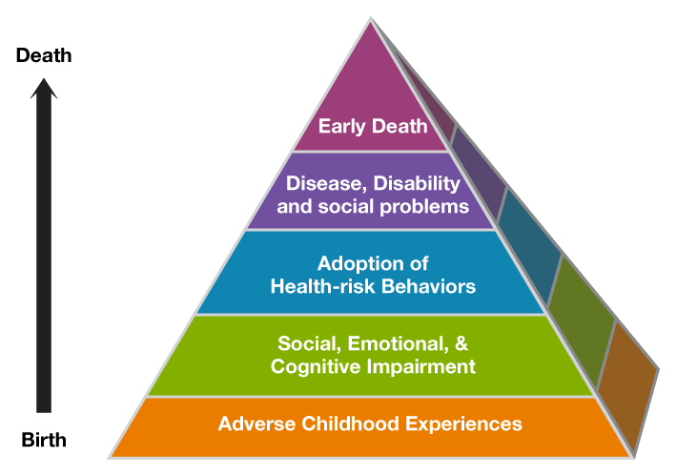
The Global Early Adolescent Study: ACES

Slide 13
ACEs Questions
4 point Likert Scale
Have you ever been scared or felt really bad because grown-ups called you names, said mean things to you, or said they didn’t want you?
Have you ever been scared that your parents or other adults were going to hurt you badly (so that you were injured or killed)?
Have you ever felt like you are not loved or cared about?
Have you ever felt like you have no one that protects you?
Has there ever been a time in your life when you were totally on your own and had to take care of yourself for more than a short time?
Have your parents or guardians ever drank too much alcohol or used drugs so they came home and were really abusive to you or your family?
The Global Early Adolescent Study: ACES

Slide 14
ACEs Questions Continued
4 point Likert Scale
Has there ever been a time when your family did not have enough food because they had no money?
Have you ever seen your mom being hit, beaten, or threatened?
Have you ever seen your mother or father so sad that they couldn’t take care of you?
Have any of your parents ever been to prison or jail?
Has your family ever been forced to leave your house/home?
Has an adult ever touched your private parts, except when being bathed?
Has an adult ever attempted or forced you to have sexual intercourse?
The Global Early Adolescent Study: ACES

Slide 15
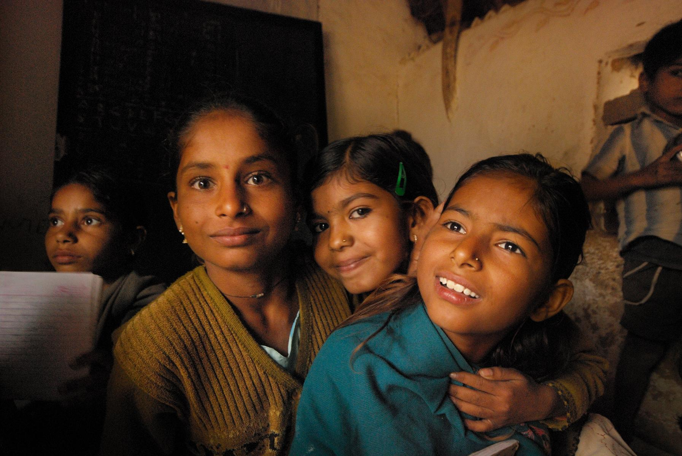
Thank You
www.geastudy.org
@geastudy

