Slide 1
Health Instrument

Slide 2
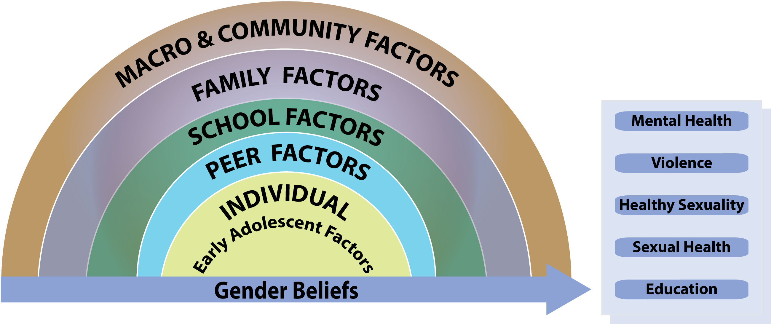
The Key Outcomes and Elements of the GEAS

Slide 3
Early adolescent health instrument
10 Modules exploring Key domains of adolescent Health & the ecological influences
Health related measures
Healthy sexuality
Romantic relationships
Sexual behaviors
Physical health and puberty
Mental health
Empowerment
Gender-based violence
Adverse childhood experiences
Ecological influences:
Sociodemographics
Individual attitudes
Family
Peers and peer norms
School
Neighborhood perceptions
Media
Gender beliefs
(scale and vignettes)
Notes:
Questionnaire, multiple-choice style, self-reported
Developed through an iterative process with all study partners. Questions drawn from existing surveys on adolescent health, and if possible, early adolescence, and further adapted to fit across these global contexts. About 10 different drafts circulated.
Some sections are context specific

Slide 4
What do we mean by Healthy Sexuality?
  Body Pride (satisfaction with physical characteristics and appearance)
  Comfort with emerging sexuality (pubertal development)
  Relational self-efficacy

Slide 5
BODY PRIDE
 | Agree a lot | Agree a little | Disagree a little | Disagree a lot
On the whole, I am satisfied with my body
I worry about the way that my body looks
I like the way I look
I like looking at my body
I feel like I am beautiful or handsome
I often wish my body were different
I like the color of my skin

Slide 6
Pubertal Maturation :
As children grow up, their bodies start to change. Thinking about your body, how fast do you feel you are maturing/changing compared with other (insert biological sex of respondent, e.g. boys/girls) your age? Faster/ About the same/ Slower
GIRLS
Have your breasts started to grow/become larger?
Have you started to have periods?
  If Yes : How old were you when you first got your period?
BOYS
  Have you started puberty? For example, has your penis or testicles (balls) started to get larger compared to when you were younger?
  Do you speak in a deeper voice now than when you were younger?
  If Yes : How old were you when your voice changed?
Have you started growing a beard?
  If yes : How old were you when you began growing a beard or mustache?
  If yes: How often do you shave?

Slide 7
Comfort with EMERGING SEXUALITY
 | Agree a lot | Agree a little | Disagree a little | Disagree a lot
I like the fact that I am becoming a woman/man
People make fun of or tease me because of the physical changes I am going through
I like that my parents may treat me now more like a man or woman
I am worried that I am not developing normally
I am worried about the pubertal changes I am going though
In general I am proud of the pubertal changes I am going through

Slide 8
Comfort with EMERGING SEXUALITY (girls)
Menstruation
 | Never | Rarely | Sometimes | Often
I feel ashamed of my body when I have my period
I’m uncomfortbale in my body when I have my period
It’s important that I keep my period secret from anyone
I feel proud that I have my periods
I wish I could never have periods

Slide 9
What do we mean by Sexual Health?
Romantic feelings (e.g. crushes)
Romantic activities (e.g. having boy/girlfriend)
Sexual activities (e.g. non-coital and coital)
Knowledge of/access to sexual health services and supplies
Sexual attitudes, norms (peer & parents), expectations
Female Genital Cutting

Slide 10
Sexual behaviors
Beyond a dichotomization of sexual “experienced” vs. “inexperience”
Wide range of activities explored:
  Holding hands, Hugging/cuddling, Kissing, “Sexting”
  Touching private parts, Oral sex, Vaginal sex
Flow and use of skip patterns
  Have you ever heard of…
  Do you know any friends who have…
  Have you ever…
Context of the first time touching, oral and vaginal sex, respectively
  Age, relationship to and age of partner, willingness
  Vaginal sex only: family planning/condoms, and alcohol/drug use
Sexual Health knowledge (HIV, family planning)
Notes:
Questions

Slide 11
Sexual activities : Progression of questions with skip patterns
  Kissing: Do you know what kissing is
    If yes: Do you know any friends who have kissed? Yes, many/ Yes, some/ No, none/ Don’t know
  Touching: Do you know what touching is? By touching, we mean touching someone’s private parts, breasts or other parts of the body in a sexual way.
    If yes: Do you know any friends who have touched or been touched?
  Sexual intercourse: Do you know what sexual intercourse is? By this we mean when a boy or man puts his penis in a girl’s or woman’s vagina.
    If yes: : Do you know any friends [peers around you] who have had sex (sexual intercourse)?

Slide 12
Sexual activities : Progression of questions with skip patterns
  Now we would like to ask you about things that YOU might have done together with someone else as more than just friends. Remember that you do not need to answer anything that you do not feel comfortable telling me about
  Tell me which of the following activities you have ever done together with someone else as more than just friends. For each activity, I also want to know if you did this with a boy or a girl. Please answer all that apply.
 | Yes, with X girl(s) | Yes with X boy(s) | No with either boys or girls | Don’t know
Spent time alone in a private space without any adults around
Held hands with someone you liked as more than just friends
Hugged or cuddled. By this we mean when two young people hold each other close as more than just friends, to show love or affection
Kissed on the lips or with tongue
Flirted with someone using a phone, emailed or social media
Sent a sexual picture of yourself using the phone, email of social media.

Slide 13
Sexual activities : Progression of questions with skip patterns
If Yes to at least one item in IXC5a-f, excluding e:
Have you ever touched or been touched by someone? By touching, we mean touching boys’ or girls’ private parts, breasts or other body parts in a sexual way.
  Yes, with ______ girl(s)
  Yes, with ______ boy(s)
  No, never
  Don’t know
Have you ever had sexual intercourse? This is when a man or boy puts his penis inside a girl’s or woman’s vagina.
  Yes, several times
  Yes, once
  No, never
  Don’t know
(→ If No or Don’t know to IXC7, skip to IXC9)
Have you ever put your mouth on someones’ genitals (private parts), or has someone put their mouth on your genitals (private parts)? (Explain genitals (private parts) for boys and girls respectively). Some people call this oral sex.
  Yes, with ______ girl(s)
  Yes, with ______ boy(s)
  No, never
  Don’t know
(In sites where possible, add questions about anal sex)

Slide 14
Sexual activities : Progression of questions with skip patterns
Now we want you to think back to the first time that you did the activities that you just told me about. I would like to know how old you were the first time they happened.
How old you when you first…[Insert activities below if ’yes’ earlier]?
 | Age in years | Can’t remember | Never did/not applicable
IA1a. Spent time alone in a private space without any adults around
IA1b. Held hands
IA1c. Cuddled/Hugged
IA1d. Kissed on the lips or with tongue
IA1e. Flirted with someone using a phone or social media
IA1f. Sent a sexual picture of yourself
IA1g. Touched someone elses genitals (private parts) in a sexual way
IA1h. Oral sex
IA1i. Sexual intercourse
IA1j. Anal sex (if added by site)

Slide 15
Sexual activities : Progression of questions with skip patterns
Ask only If Yes to IX6C (touching):
The first time you either touched or were touched by someone (touching private parts, breasts or other parts of the body in a sexual way), what was you relationship to this person?
How old was this person?
The first time you touched or were touched by someone, would you say you were willing, somewhat willing or not willing at all to? Willing means you gave permission or said it was OK, or that you did it because you wanted to and not because someone made you.

Slide 16
Four key domains of Empowerment in Early Adolescence:
Freedom of movement
  Whether I can do activities alone (without adults), e.g.: sports, parties, youth center, meet(opposite/same-sex friends after school
Voice
  Whether my parents and peers listen to me, ask for my advice/opinion, and whether I can speak up or ask for help.
Behavioral control/decision-making
  Whether I can make decisions on my own, e.g. about school, what to wear, how to spend my free time, who my friends are, when/who to marry
Future expectations
  What I expect will happen in my future, e.g.: number of children, age of puberty, marriage, first child and leaving school.

Slide 17
Adverse childhood experiences (aces)
Whether as a child you experienced the following:
(Never, sometimes, often, don’t know)
Fear about adults (e.g. said mean things or that they would hurt you)
Feelings of neglect (e.g. not loved/cared for, no one protects you)
Abandonment (had to take of yourself/were completely on you own)
Parental alcohol abuse and violence (e.g. your parents drank to much, saw your mothers be hit or threatened)
Parental criminality (had a parent in prison/jail)
Unstable housing (your family was forced to leave your home)
Sexual abuse (e.g. adult touching of private parts or forced sex)*
*Optional by sites

