Slide 1
Global Early Adolescent Study
December, 2018

Slide 2
Gender Norms Scales
In the Global Early Adolescent Study
The Global Early Adolescent Study: Gender Norms Scales

Slide 3
Gender Norms Scales
Scale with statements and multiple response options
Designed to:
Measure young adolescents’ perceptions, attitudes or beliefs about gender norms (i.e. about masculinities and femininities)
Identify common gender norms across different cultural settings.
The Global Early Adolescent Study: Gender Norms Scales

Slide 4
Background and Objectives
Gender System
Common value system in which women are subordinated to men.
Embodied in social norms, a mechanism for maintaining social order
Gender Intensification Hypothesis
In early adolescence, gender “opens up” again as part of transitions into adolescence
GEAS Formative Research Objective
Is there a common set of norms regulating male and female relationships in early adolescence that are common across cultures?
The Global Early Adolescent Study: Gender Norms Scales

Slide 5
Mixed methods & cascading approach
Instrument Development:
Grounded in the Voices of Young People
interviews 450 dyads (adolescents & parents) recorded, translated, and coded
Site specific/ cross cultural
Qualitative analysis
Stems for vignettes
3 day Workshops with 12 adolescents/site
Cross cultural /site specific Gender themes and gender codes
Vignettes about gender equitable relationships
Gender Norms Scales
The Global Early Adolescent Study: Gender Norms Scales

Slide 6
Qualitative Study
Methodological Approach
Data collection
In-depth interviews with 30 adolescents 11 -13 years/site in 7 sites (Assiut, Baltimore, Edinburgh, Ghent, Ile Ife, Shanghai, Nairobi) exploring gendered transitions from childhood to adolescents conducted between 2014 and 2015.
Analysis
Inductive thematic analysis based on data related to gender norms
Codes grouped by themes and compared across sites to identify emerging cross-cultural gender norms themes (domains of the gender norms instrument). The data also served to populate a bank of items reflecting the different domains.
The Global Early Adolescent Study: Gender Norms Scales

Slide 7
Qualitative Study
Results: Emerging Cross-cultural Domains
Domain | Boys | Girls
Gender Stereotypical Traits | Independence | Vulnerability
 | Toughness | Importance of attractiveness
Gender Roles | Protection | Deference
Gender Norms about Relationships | …are naturally attracted to girls | …are responsible for arousing boys
 | …have girlfriends for social capital rather than love | …face social risk if they have boyfriends
 | …should ascribe to heteronormative norms in their romantic relationships with girls | …should ascribe to heteronormative norms in their romantic relationships with boys
The Global Early Adolescent Study: Gender Norms Scales

Slide 8
Quantitative Instruments
6 Domains, 44 Items, Boys
Boys’ have girlfriends for social gain rather than love | Boys have girlfriends to show off to their friends
 | Boys should have girlfriends to discover love
 | Boys feel they should have girlfriends because their friends do
 | Boys have girlfriends for fun more than love
 | Boys tell girls they love them when they don't
 | Boys lose interest in a girl after they have sex with her
 | Boys fool girls into having sex
Boys are naturally attracted to girls | Boys are supposed to be attracted to girls
 | It's in boys' nature to chase girls
 | Boys generally compete for the prettiest girls
 | Boys like girls who wear revealing clothes
Normative Romantic Relationship Expectations for boys | It's ok for a boy your age to be in a relationship with a girl as more than just friends
 | Boys judge girls on their character rather than on their looks
 | It's ok for a boy to have a lot of girlfriends
 | It's ok for a boy to have more than one girlfriend at a time
 | It's ok for a boy and girl your age to talk and spend time together alone
 | It's ok for a boy your age to talk and spend time with a girl alone
The Global Early Adolescent Study: Gender Norms Scales

Slide 9
Quantitative Instruments
Girls
Girls are responsible for arousing boys | Girls should cover up or they will attract unwanted sexual attention
 | Girls should be careful about the way they look so they are not seen as trying to seduce men
 | It's a girl's fault if boys come onto them
 | Girls wear short dresses to get boys' attention
Girls should keep boys at a distance or they will get in trouble | Girls should keep boys at a distance
 | It's not good for a girl to spend time alone with a boy
 | Girls often get into "trouble" when they have boyfriends
 | Girls who have boyfriends are irresponsible
 | Girls should be aware that boys can take advantage of them
 | Girls are the victims of rumors if they have boyfriends
 | A girl will lose interest in studying if she has a boyfriend
Normative Romantic Relationship Expectations for girls | It's ok for a girl to have more than one boyfriend at the same time
 | It's normal for a girl to want a boyfriend at your age
 | Girls who have boyfriends are popular
 | A girl can have a boyfriend as long as she continues working well in school
 | It's ok for a girl your age to be in a relationship with a boy as more than just friends
The Global Early Adolescent Study: Gender Norms Scales

Slide 10
Where do the Gender Norms Scales Fit Into the Survey?
Health instr.
Vignettes
Gender norms scale & vignettes scattered within the health instrument modules
Gender scales
Full toolkit (tablet survey)
The Global Early Adolescent Study: Gender Norms Scales

Slide 11
Discussion
Conceptual challenges to construct cross cultures measures of social norms among early adolescents
Common domains (but expressions are often culturally specific)
Personal beliefs versus normative expectations: Developmentally challenging to assess among early adolescents
The Global Early Adolescent Study: Gender Norms Scales

Slide 12
Conclusions
Common social norms regulating gender relations in early adolescence
Discordant norms for girls: sexual double standard and normative expectations about romantic relations
Current
Confirmatory analysis
Test of associations with Gender based violence, sexual health and mental health indicators
The Global Early Adolescent Study: Gender Norms Scales

Slide 13
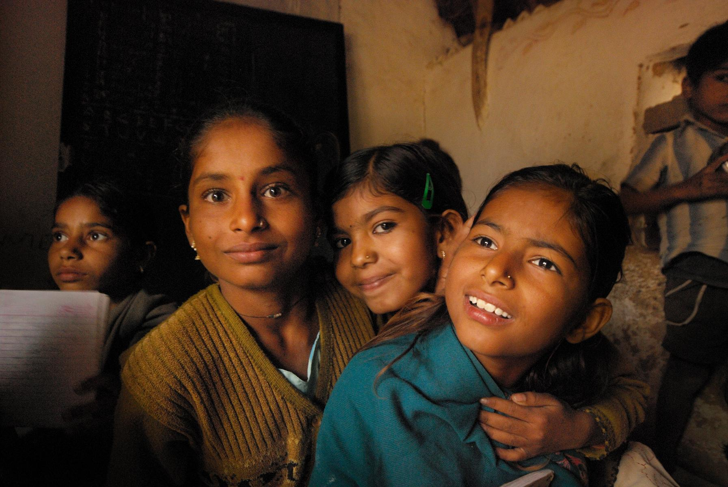
Thank You
www.geastudy.org
@geastudy

