Slide 1

PARTICIPATORY
DATA COLLECTION METHODS
FOR VERY YOUNG ADOLESCENTS
REBECKA LUNDGREN
INSTITUTE FOR REPRODUCTIVE HEALTH
GEORGETOWN UNIVERSITY

Slide 2
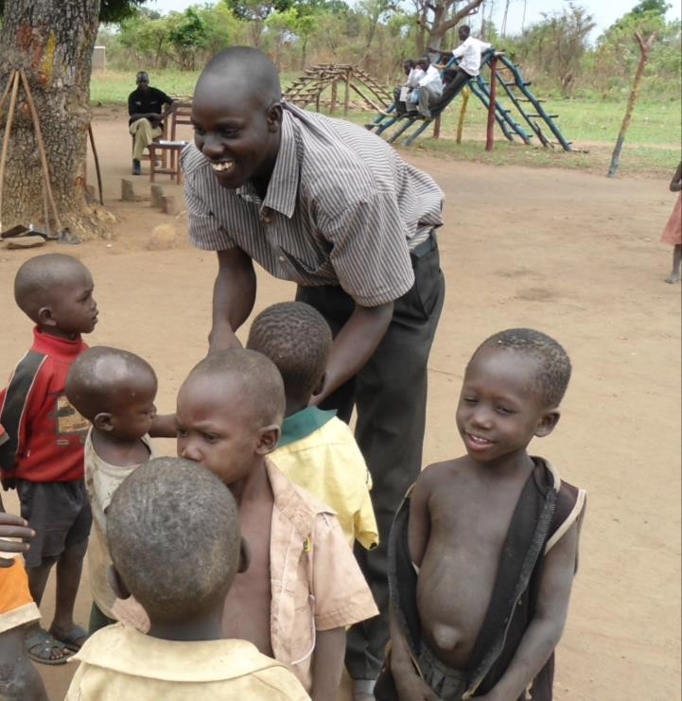
KEEPING CHILDREN IN THE CENTER OF OUR RESEARCH
“Listening to the voices of children themselves (rather than what adults say about them) reveals what is important to them, such as the patterning of gender in children’s social relationships.”
ALISON JAMES, 2007
Notes:
Keeping children in the center of our research
Child-centered research: Empower young voices to speak and be heard
Seeking children’s felt experiences not adult concerns
Studies for or with children vs. studies on or about children
Most research among VYA relies on retrospective reports from older counterparts and is often limited to measure knowledge changes.
Young adolescents can be reliable, competent informants

Slide 3

How is conducting an interview with an 11 year-old different from interviewing an adult?
Notes:
How are interviews with children different from interviews with adults?
- Social power/hierarchy
- Cognitive/verbal ability
- Attention span/ ability to sit still
- Used to adults telling them what to do/pleasing adults

Slide 4
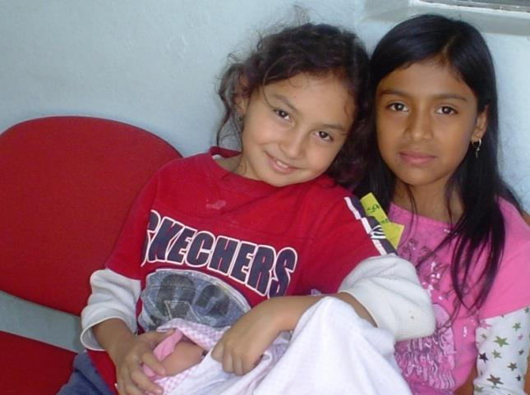
What can we do during interviews to make sure we hear children’s voices?
Notes:
-Put them at ease
Child friendly methodologies
Methods that actively engage kids
Qualitative methods that help us view the world from their perspective

Slide 5
WHY USE PARTICIPATORY, QUALITATIVE METHODS?
Traditional research methods
Advantage adults in terms of social or communication skills and knowledge
Qualitative methods
Explore meaning, processes, explanations
Participatory methods
Shift balance of power
Include verbal and visual communication

Slide 6
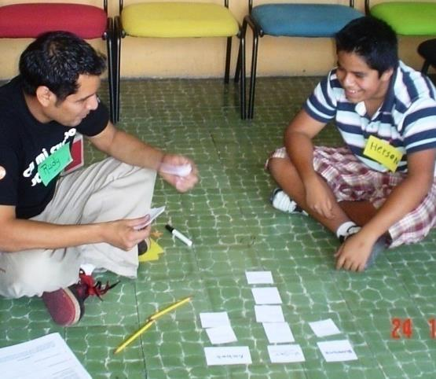
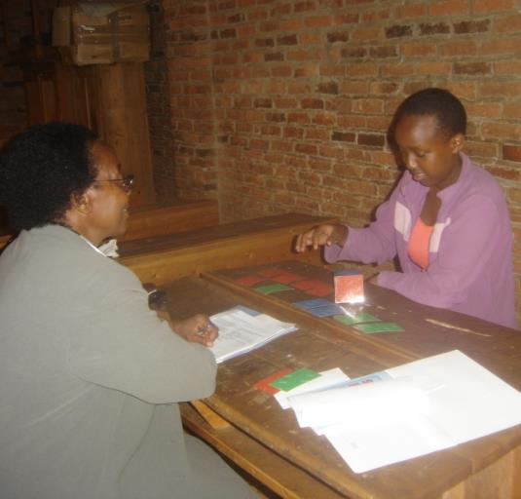
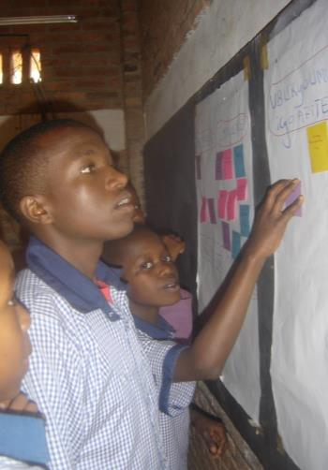
COMBINING VISUAL AND VERBAL COMMUNICATION
REDUCES DEMANDS ON THE PARTICIPANT
Notes:
Use methods allow a combination of visual and verbal communication
reduce the need for written literacy
establish rapport
- provide children a focus other than the interviewer, reducing the social and emotional demands of the interviewer

Slide 7
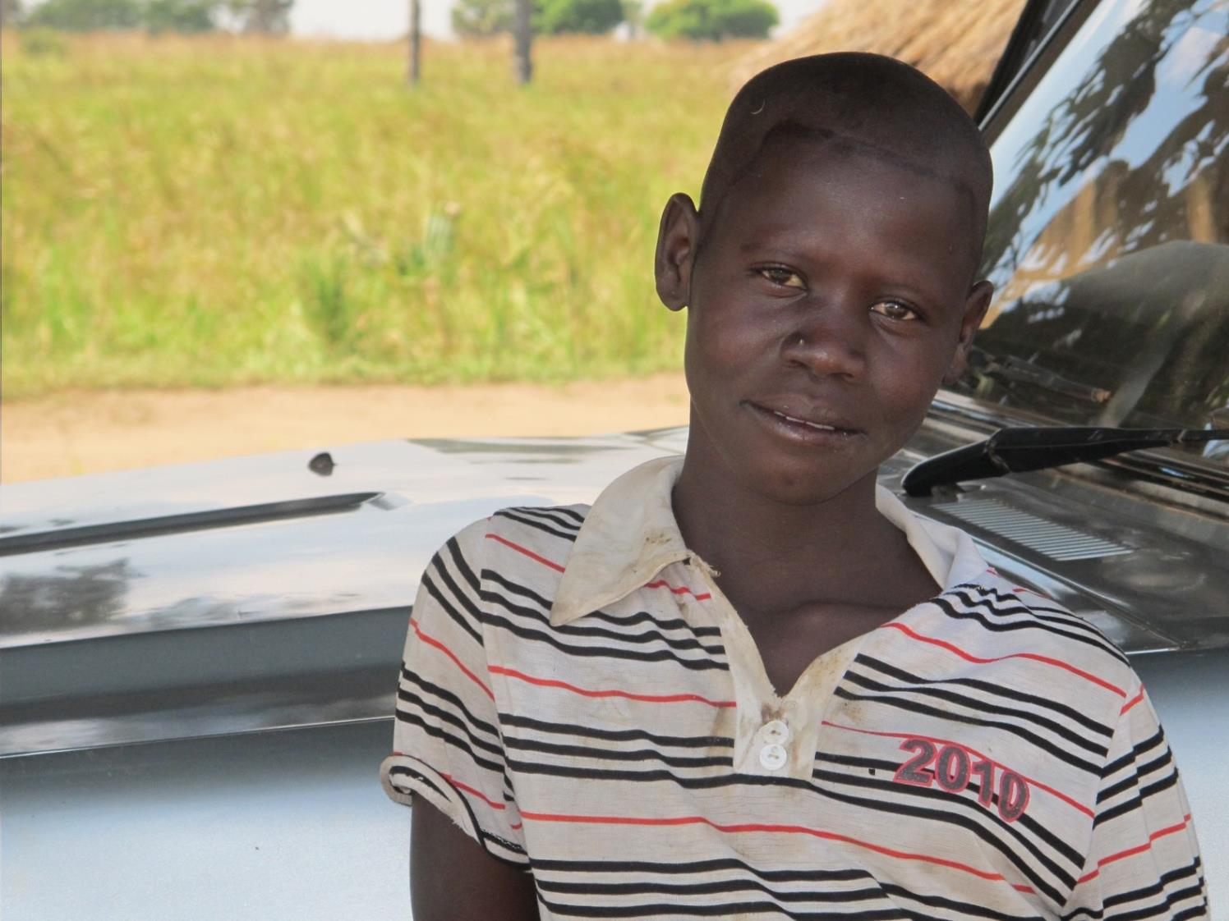
GIVING YOUTH MORE CONTROL WORKS
Notes:
Methods give control:
Projective/metaphorical techniques = explore meanings, emotions and values
timelines = let children take the lead
mapping, photovoice –=let children express themselves visually
Empower them whenever possible:
where to do the interview
where to sit
order of activities

Slide 8
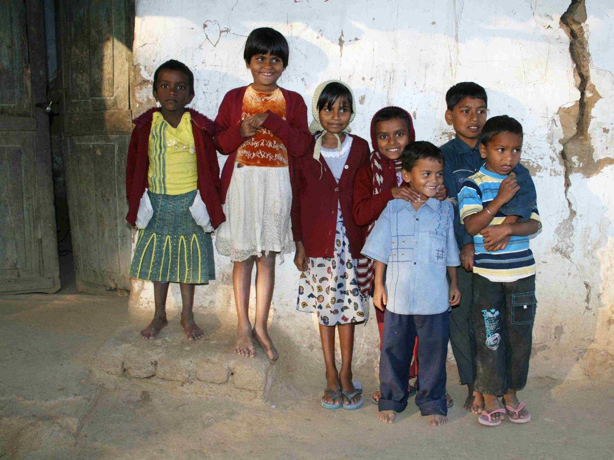
Break social norms – power share
Explain new rules
Put participants at ease
Notes:
Social norms (adult usually in control)
Let participants make decisions
Explain new rules
- They are experts about topics grown-ups know little
- Did you notice teachers ask questions they already know the answer to? Well the questions I’m going to ask I don’t know the answers to, because only you know these things not me.
Help them get comfortable
- Spend time to get to know them at the outset
Bring specific, age-appropriate tasks
Avoid settings associated with adult power- classrooms, happen in a child’s comfort zone

Slide 9
Participatory, visual,
game-based methods
Card games
Vignettes
Photo elicitation
Projective drawing
Collages
Mapping
Role play
Puppets
Notes:
Pre adolescents do better with tasks that involve direct manipulation or use visual props than vague verbalization
- the younger the child (11 and under), the more they benefit from game like activities and concrete prompts (photos, toys, acting out a phone conversation, using a puppet, looking at pictures rather than questions)

Slide 10
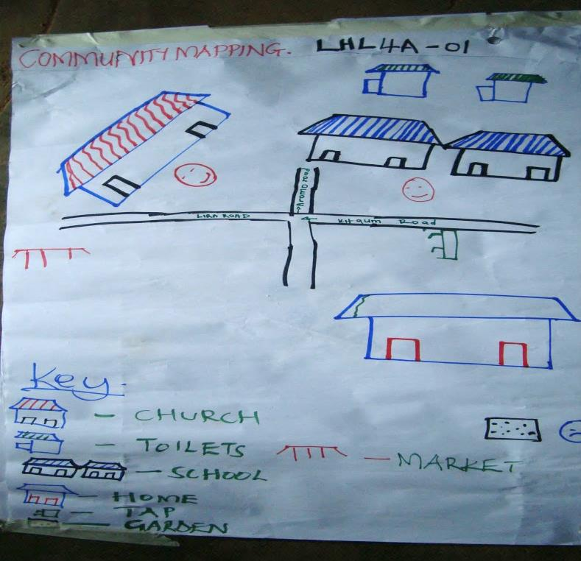
Tips for interviewing children
Avoid entirely talk-based interview
Start and end with fun, up-beat tasks
Vary tasks and use visual and verbal communication
Incorporate movement
Notes:
Avoid question after question for an entirely talk-based interview
Start and end with easy, upbeat tasks (often drawing)
Vary tasks over time
Look and listen- children communicate on more than one channel
Let children communicate visually and verbally (collage, drawing, role playing, making puppets)
-make anything possible into a game, incorporate movement when possible (sorting cards- throw, jumping, slapping)

Slide 11
GEAS
APPROACHES

Slide 12
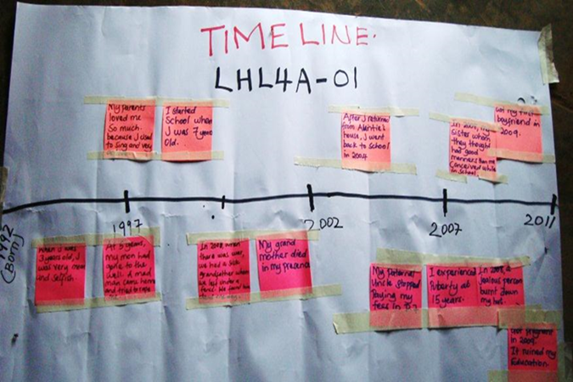
Understand gendered perceptions of the concept of “adolescence”
Boy and Girl Timeline
What animal represents
an ideal man/woman? Why?
Small same-gender groups develop timelines, then discuss in plenary
Purpose: Understand how boys/girls conceptualize life stages and identify challenges and opportunities of growing up
Put the youth at ease with the interviewers and the topics
Notes:
Purpose:
What are similarities and differences in ways boys and girls perceive adolescence?
What are main challenges/opportunities for a child becoming an adolescent boy or girl?
Group activity (4-6) boys or girls.
Step 1: Develop two timelines – develop a boy and a girl timeline.
Step 2: Come together and compare and discuss questions in the guides.
Directions: You are going to work in two small group to make up a story about a child who lives in your community. One group will work on the story of a girl, the other a boy. What shall we call them?
On this piece of paper, I have put a mark for the day John was born. This line marks the point that John has become an adult man. All of the space in between shows days and years in between. (same for Mary)
You are going to write all of the important events and changes in their lives during this time.
Step 2: Bring group together and put timelines on the wall. Start with follow up questions having them describe the timelines and comparing and contrasting the two. Then use the questions to facilitate discussion

Slide 13
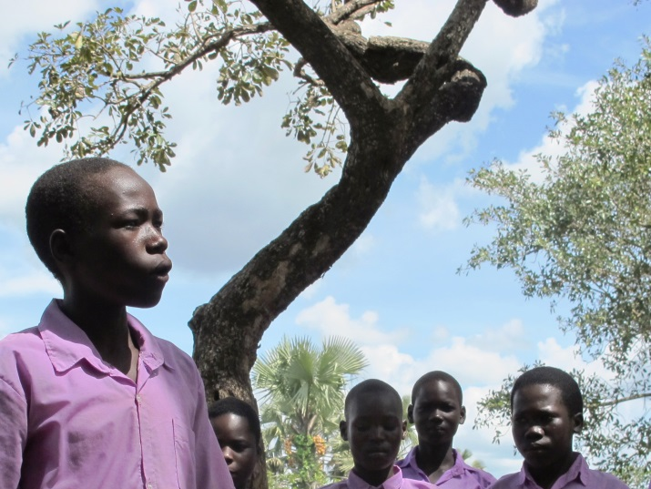
“He is noticing changes in his body and his voice is changing. He is developing interest in a girlfriend because he wants someone to keep him company. His friends are telling him he should get a wife and bring her home. He wants to wait until he has a hut for sleeping.”
- Boy, 13 - Uganda
“In that time, he feels he should be with a girl he likes. But it is hard to get her since you are scared. You have so much desire to be with a girl. So you struggle to get her.”
Boy, 14 - Uganda

Slide 14
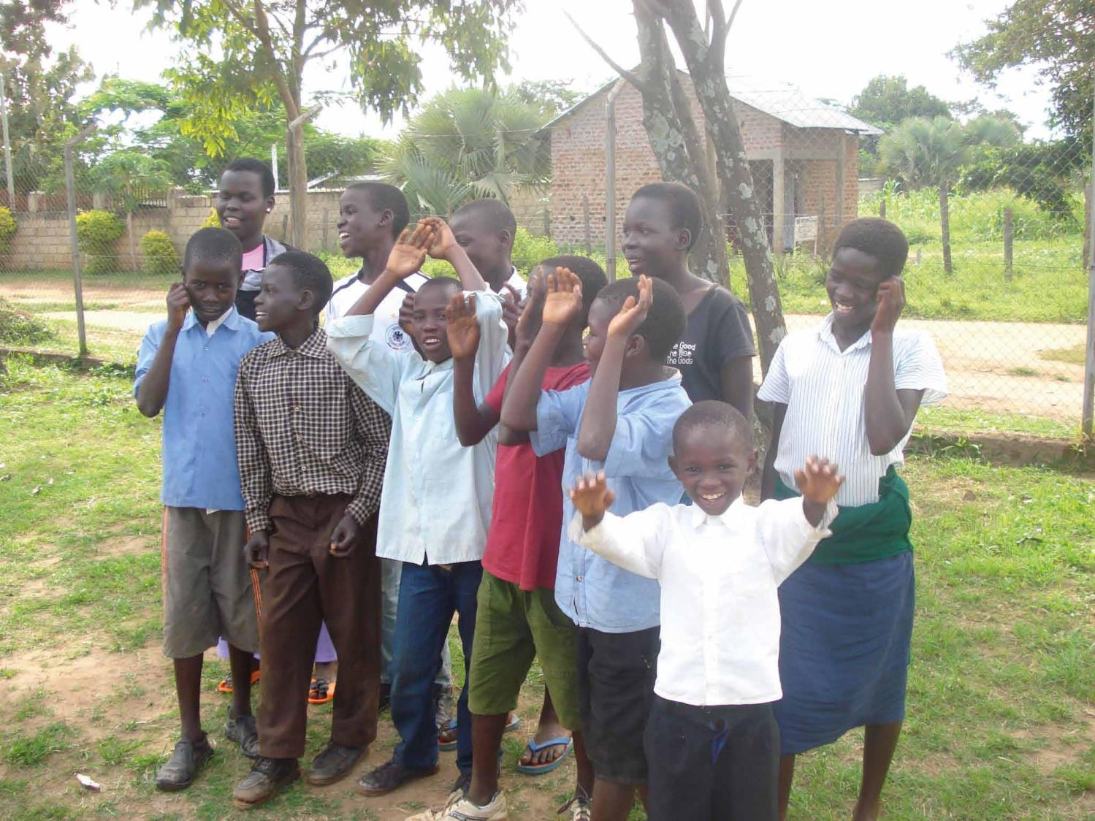
“At this time a girl starts to develop breasts and begins to associate with friends of the same size. She will demand to sleep in her own house. She wants to be smart (attractive) so that men see her. She puts on clothes that show her breasts. Her walking style changes. She is now showing signs of maturity.”
Girl, 13 - Uganda

Slide 15
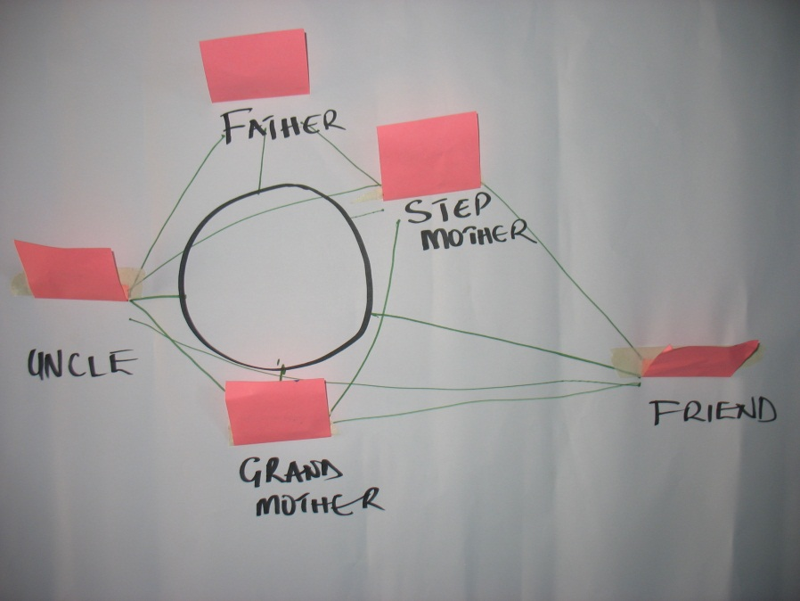
Understand interpersonal relationships
Individual “warm up” activity
Build rapport and learn about social context
Identify relationships and explore how gender influences relationships during transitions into adolescence
Establish base for narrative interview
Venn Diagram
Notes:
One-on-one activity, after consent, before narrative interview, in private
Explain you are interested in learning about the people in their life – there can be good and bad relationships with family, friends, teachers, religious leaders and others.
Ask them to create a map of all the people in their lives. Ask them to draw one circle for each person. They don’t need to use real names, or can make up names. Size of the circle will reflect how important the person is to them – large if important, small if not. Put the circles close if people know each other/far if they don’t. After they have drawn (5 to 10 minutes) , ask them to draw a smiley or sad face depending on how they feel about the relationship.

Slide 16
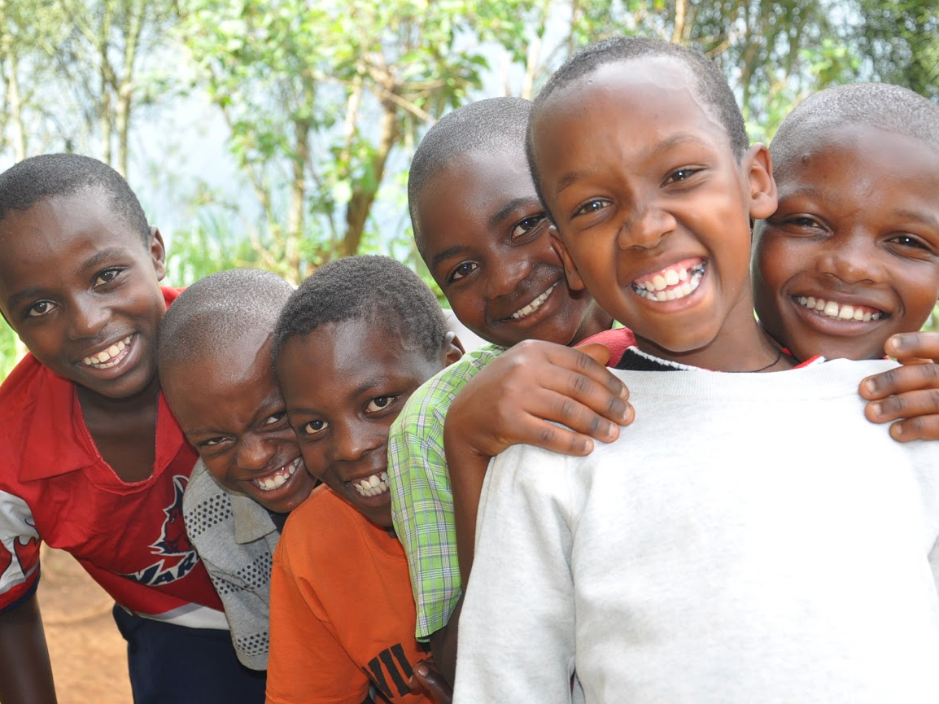
“My father is always occupied with his activities and does not like to hear these types of questions. He is not there most of the time.”
(12 year old boy, Rwanda)
“I can trust my mother. She makes me feel confident. She tells me not to be afraid of what is happening.” (13 year old girl, Guatemala)

Slide 17

?
What does it take to be an effective note taker?
Notes:
Strategic: rather than try to take notes of every detail or quote, write down key words that will trigger your memory when you expand your notes
Organized and Efficient: Develop short-hand system. Since you will expand and type your notes soon after you write them, it doesn’t matter if you are the only person who can understand your short-hand system. Use abbreviations and acronyms to quickly note what is being said
Observant: It is important to cover a range of observations. In addition to what people say, note body language, moods, attitudes, general environment and any other relevant things
Discrete: when operating recording equipment or taking notes, should not distract the participant
Ability to synthesize information: this is particularly important as you expand your notes so that they can be shared with research team

Slide 18
Note taking
Task | Tips
Recording | Test recorder and label appropriately Bring extra batteries Set up in advance, be discrete
Expand notes | The same day! Rich description
Participatory activities | Include ID code on drawing/timeline Photograph visual output and attach to transcript Document process on structured observation guides
Documentation | Use cover page Always include participant identification code
Notes:
Try to expand notes immediately after interview or before you go to bed. The sooner you review your notes, the greater the chance that you will remember other things that you had not written down. Good note-taking often triggers the memory, but with the passage of time, this opportunity is lost.

Slide 19
What to include in notes?
Why are the notes so important?
What to include
Why
Participant engagement
Interruptions, distractions
Behaviors
Non-verbal communication
Key terms
Stories/comments outside of interview
Back-up if recording unclear/participant turns off recorder
Provides context & helps to understand transcripts
Non-verbal communication carries meaning

Slide 20

Transcribing Data
Transcription should begin as soon as possible
Note nonverbal sounds and background noise (laughter, crying, knocking on door)
Do not “clean up” the transcript. Transcribe words exactly as the interviewer or participant said them.
Proofread, check transcripts for accuracy
Notes:
Remember that the transcripts represent a real live person, discussing some of the most interesting, intimate details of his or her life. This is valuable information few people have access to and we have a responsibility to respect it.

Slide 21
Verbatim transcription: A few rules
Transcribe contractions (betcha, cuz, ‘wanna) Transcribe fillers (hm, huh, ugh, whoa, ahah)
Transcribe repeated words (I went to the clinic to see, to see the nurse).
Indicate difficult to hear segments [Inaudible: 2 minutes missing]
Mark short pauses (. . .) and (long pause).
Indicate possibly inaccurate word (?(school)?)
Replace name with Participant ID#.
Notes:
Yes verbatim means EXACTLY as recorded, not paraphrased.

Slide 22
!
If information doesn’t appear in the transcript and notes, it doesn’t exist for the study.
Notes:
It is the only way for those of us who are not actually in the field to understand all the valuable work you actually do. It is also the only way we can communicate our findings to others

