Slide 1
Note-taking
Anna Kågesten, MPH
Johns Hopkins School of Public Health
GEAS Qualitative Study training
February 3rd, 2015

Slide 2
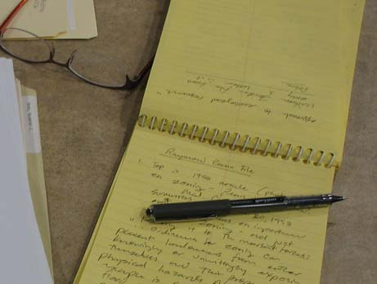
Why take notes?
Help characterize participant’s behavior and context
Document themes and questions to address in future interviews
Trigger memory, help asking questions
Aid in transcription
http://www.williamcronon.net/researching/interviewimages/932_oral_histories_fig06_lowres.jpg

Slide 3

?
What does it take to be an effective note taker?

Slide 4
Note-taking tips
Be strategic: Capture key words and phrases instead of full quotes
Shorthand rather than computer
Use a format you feel comfortable with
Abbreviations and acronyms
Expand on notes as soon as possible after interview
Notes:
Strategic: rather than try to take notes of every detail or quote, write down key words that will trigger your memory when you expand your notes
Organized and Efficient: Develop short-hand system. Since you will expand and type your notes soon after you write them, it doesn’t matter if you are the only person who can understand your short-hand system. Use abbreviations and acronyms to quickly note what is being said
Observant: It is important to cover a range of observations. In addition to what people say, note body language, moods, attitudes, general environment and any other relevant things
Discrete: when operating recording equipment or taking notes, should not distract the participant
Ability to synthesize information: this is particularly important as you expand your notes so that they can be shared with research team

Slide 5
What to include in notes, and why?
What to include
Why
Group/individual ID code
Participant engagement
Interruptions, distractions, reluctance to answer, emotions
Participant’s behaviors
Non-verbal communication
Key themes and terms
Stories/comments outside of interview
Records/tracking
Back-up if recording unclear
Provides context & helps to understand transcripts
Carries meaning on its own
To guide questions/plan next interview

Slide 6
Process
Adolescent group interview (timeline)
1-2 people take detailed notes of both the construction of timelines, and the discussion
Summarize notes on note-taking form A immediately/ASAP afterwards
Adolescent individual interview
Not necessary to take notes, might disturb flow
Summarize thoughts on note-taking form B immediately/ASAP afterwards
Parent interview
Might want to take brief notes as memory cues
Summarize thoughts on note-taking form C immediately/ASAP afterwards

Slide 7
logistics
Fill out forms by hand
Type up your notes and send by email
(All notes should be given to field coordinator)

Slide 8
!
If information doesn’t appear in the transcript and notes, it doesn’t exist for the study.
Notes:
It is the only way for those of us who are not actually in the field to understand all the valuable work you actually do. It is also the only way we can communicate our findings to others

