Slide 1
Data Management
Logging into SurveyCTO
Data Management Guides
Setting up the tablets
Data collection
Downloading SurveyCTO Sync to PC’s
Downloading the data

Slide 2
Logging into SurveyCTO server
https://servername.surveycto.com/index.html to access server from PC
http://servername.surveycto.com/collect for data collectors from tablets
Server name: your_servername
Email Address or username: Either the Data manager’s email address or for the data collectors – “site-collector”
Password: Your password
All DC’s use same username and PW and can upload data and download forms. DM have individual email addresses and PW’s and can do all things and download data.

Slide 3
Data Management Guides
One for DM’s and one for DC’s
PDF files which list responsibilities of DM’s and DC’s
Provide step by step descriptions for accomplishing tasks

Slide 4
Setting up the tablets
Three apps are necessary to set up on each tablet
SurveyCTO Collect
Avira Antivirus Security
Barcode Scanner

Slide 5
SurveyCTO Collect
Connect to Wi-Fi, open the browser on the tablet,
go to http://servername.surveycto.com/collect
click “Download Android app.”
NB: the SurveyCTO Collect app in the Google Play Store is NOT the one we are using. You must download it from the website above.

Slide 6
Avira Antivirus Security
Go to Google Play Store. To access the Google Play Store, you will need to use a Google account. You may create one for your site.
Avira can be used to scan for viruses AND as an app locker to prevent kids from using other apps while taking the survey. To set this up, simple choose “App Lock” from the list of available services and follow the instructions and choose a passcode. We suggest locking all apps, even SurveyCTO, so that only a person with the passcode can open them.
You can also use Avira to lock the home screen of the tablet so that it requires a passcode to access it.

Slide 7
Barcode scanner
From the Google Store, download and install an app called “Barcode Scanner” made by ZXing (this is the only barcode scanning app that will work with SurveyCTO Collect).
When asked to enter the participant ID, the SurveyCTO Collect app will open Barcode Scanner and allow the data collector to scan the QR code on the participant’s ID card, greatly reducing human error.

Slide 8
Encrypt the tablet
The next thing to do is to encrypt the tablet. This is done under Encrypt tablet. Follow the instructions on the tablet. This can take up to an hour and the tablet must be plugged in.
In this way the personal information of the respondents cannot be breached even if the tablet is lost or stolen.

Slide 9
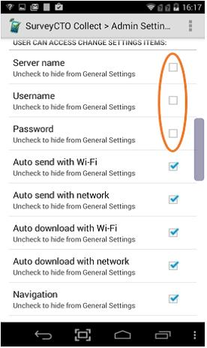
SurveyCTO Settings – DC Access
You should limit DC access to certain SurveyCTO Collect app functions.
To limit settings, tap the three dots in the upper right-hand side of the screen and select Admin Settings.
Please “hide” (uncheck) the following functions/
buttons so that DC cannot change them:
Manage Cases
Delete Saved Form
Server name
Username
Password
Name this form

Slide 10
Data collection
First thing is to activate Wi-Fi.
On the tablet open the SurveyCTO collect app that you downloaded earlier. The screen will have the following buttons appear:
Fill Blank Form
Edit Saved Form
Send Finalized Form
Get Blank Form
Then click “Get Blank form” and a list of all forms will pop up. Download the appropriate parent and child forms for your country.
Click “Fill Blank Form” and choose appropriate form and begin interview.
Normally the survey will appear in the default language, but since we don’t have translations in yet you will need to change the language to English.
Tap the 3 dots in the upper right corner. In the dropdown menu pick “Choose language” and then click English.

Slide 11
Data collection (continued)
Near the end of the survey the interviewer (or respondent if self administered) will be asked to enter a finalization code. This is to prevent the respondent from going too far. The only acceptable code is “2015”.
When survey is completed, you will be asked to finalize and save the survey. Be sure to SAVE it.
Then use the “Send Finalized Form” button to upload the record to the server. The only time you need to be connected to the internet is when first downloading the blank forms to the tablet and when sending the finalized forms to the server.
If the respondent decides at anytime to end the survey for good, then the interviewer will need to finish out the survey filling in “refuse to answer” for all remaining questions. If the survey must be stopped, but will be completed at a later time then you can click the 3 dots in the upper right corner and save the info up to the current point and then use the “Edit Saved Form” button later to re-open it and continue.

Slide 12
Downloading SurveyCTO Sync
Data managers will be able to download data from the server, and should do so at least weekly to check it for data quality.
You must first download SurveyCTO Sync app to your PC.
To do this:
Log into the SurveyCTO server and click on the “Export” tab. In the third paragraph you will see blue highlighted text. Click on the appropriate operating system. Save the .exe file to your PC and run it to install Sync.

Slide 13
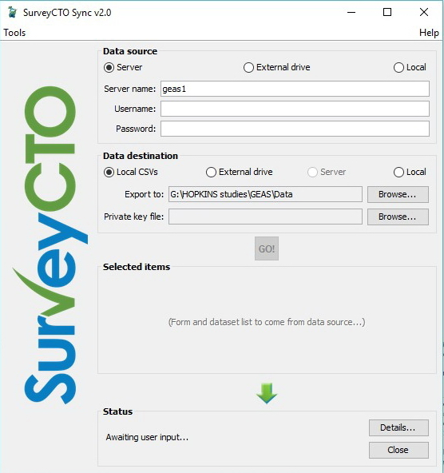
Downloading the Data
Open Sync and fill in Server and user names and PW.
Set location on PC where you wish to store the data.
Click “GO!”
List of data files appears under “selected items”. Check the ones from your country to download.
Before hitting the second ”GO!” check the box “Show export options after download”. Then hit “GO!”.
Data are stored as comma delimited CSV files. We want them in an easier format to work with. To do this, click on “Generate STATA Templates”; this will generate a STATA .do file that when run will set up the data with variable names and labels.
We mostly use STATA here and can stat-transfer it to just about any other format, but if you do not we can work something out. There is also a basic analysis package on SurveyCTO that can be used.

