Slide 1
Preparing for Fieldwork
Working as a team.
Lydia Animosa
Friday October 30, 2015

Slide 2
GEAS Organizational Structure for Data Management
Hopkins Coordinating Committee (HCC)
Site PI
Site Field Coordinator (FC)
Site Data Manager (DM)
Advisory Committee
Data Collectors (DCs)/Resident Enumerators
Young Adolescent Participants
Site Advisory Committee
Notes:
They will be familiar with this from intro to the GEAS and other presentations.
For the pilot we will have 120 youth participants. For Phase 2, 1400. Right now, we are focusing on the pilot.

Slide 3
Data Collectors vs. Resident Enumerators
During the pilot (Phase 1), sites will typically use “data collectors.” These are people who are easy to train (perhaps university students) and will be able to interview youth in the pilot over a period of 5-6 months.
During Phase 2 (longitudinal study), sites may choose to use “resident enumerators”– people living in the community with the youth who can be counted on work in their role for the duration of the study (5 years).
The benefits of employing resident enumerators are:
They are better able to track and contact youth participants
Improved rapport with youth participants
They will stay in the community for the duration of the study (unlike students who may graduate and move away)
Community capacity-building
Drawbacks:
Require more training
?

Slide 4
Characteristics of Data Collectors
Minimum Requirements:
Literate (senior high school or higher)
Moderately tech-savvy
Resident of your site
Going to stay in the community (not move away)
Mature, responsible, discreet
Open-minded and non-judgmental
Fluent in the local language
Able to attend the training
Access to transportation

Slide 5
Data Collector Expectations
Attend all trainings
Adhere to research ethics standards
Collect quality data in a timely manner
Communicate with data manager
Provide weekly progress report
Speak weekly (phone call preferred)
Call DM if s/he makes a mistake in the form
Call DM if s/he feels unsafe or needs help solving a problem
Reach out to any DC making slow progress or collecting low-quality or unusual data, and inform your site-PI.

Slide 6
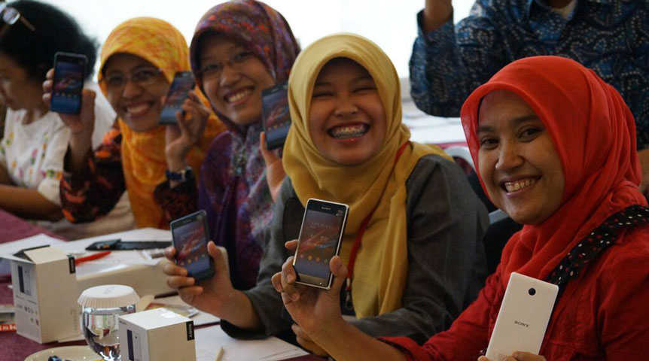
What strategies will you use to recruit data collectors?
PMA2020 resident enumerators in Indonesia

Slide 7
What strategies will you use to recruit data collectors?
Here is what PMA2020 trainers thought…
District health officials, community leaders to help find data collectors
Issue announcements about recruitment and solicit applications
Family planning office at the district level
Could also be effective for GEAS

Slide 8
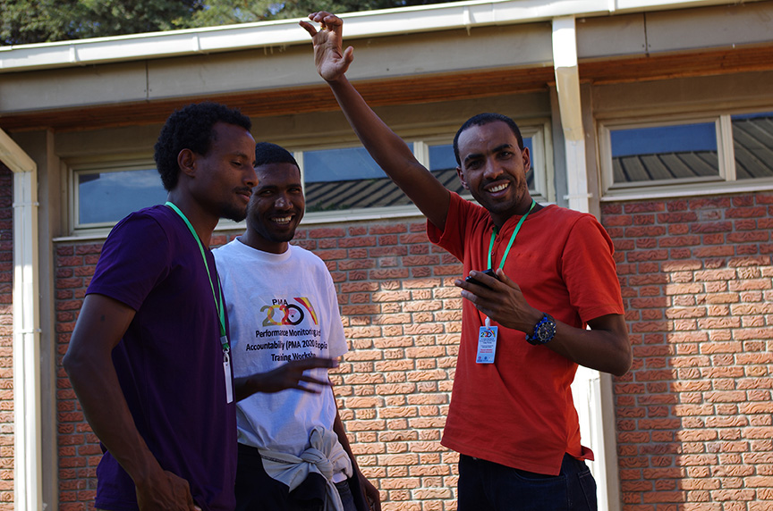
What do you think are your responsibilities as supervisors of data collectors?
PMA2020 enumerators training in Ethiopia

Slide 9
Supervising Responsibilities
Recruit data collectors (with help of site-PI & FC)
Train data collectors (with help of site-PI & FC)
Supervision & quality checks
Ensure DCs have ample airtime/data
Check-in with DCs at least once per week, preferably by phone
Investigate discrepancies in your data management vs. DC progress reports
Monitor and communicate progress/problems to your site-PI and the HCC (Mark Emerson & Lydia Animosa) on a weekly basis

Slide 10
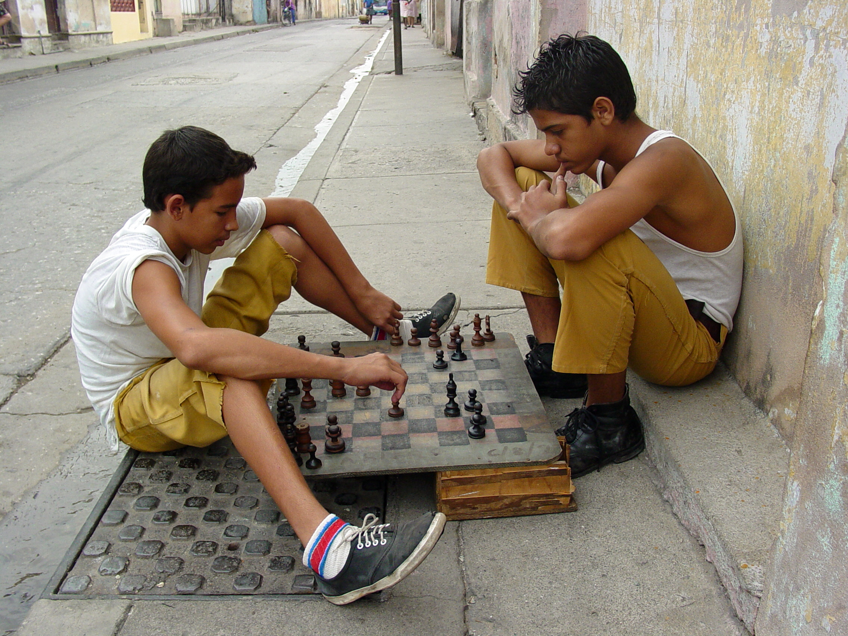
What do you think are the responsibilities of the site-PI and FC?

Slide 11
Site-PI and FC Responsibilities
Training and Training Preparation
Carry out all training prep work: securing a facility, preparing materials, coordinating fieldwork, etc.
Train DCs in survey content and methodology
(your role is technical training)
Fieldwork Support
Intervene if a DC’s quality suffers and does not respond to DM feedback
Coordinate data collection sessions and communicate with DCs about their dates/times

Slide 12
What do you think are the responsibilities of the Hopkins Coordinating Committee?
Dung Hoang for JHSPH Magazine

Slide 13
Hopkins Coordinating Committee Responsibilities
Program Management
Co-develop work plans/budgets
Communicate survey changes and solicit feedback
Representation
Introduce the project to stakeholders/other donors
Promote the platform
Financial Oversight and Support
Oversee/support financial management and reporting
Training
Develop training materials
Train data managers
Technical Support
Support data monitoring, management, and cleaning
Liaise with SurveyCTO, backstop site-DMs
Support data analysis
Support report preparation, editing, and layout
Support dissemination activities

Slide 14
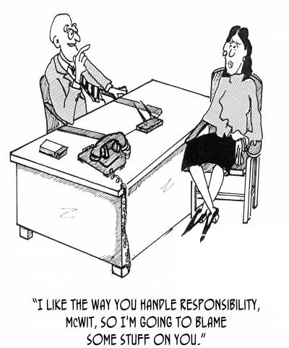
Shared Responsibilities
Participation in training
Commitment to quality
Ethical research practices
Professional conduct
Communication

Slide 15
Commitment to Quality
Know the tools: In-depth understanding of the survey tools is a requirement
Any deviations from fieldwork protocol must be communicated to the site-PI and the HCC as soon as possible
Data managers must monitor the data collection server daily and provide weekly or as-needed progress reports to the field
Data managers & site-PIs must promptly investigate any potential problems.
Failure to investigate identified problems or failure to report knowledge of data falsification will lead to dismissal.
Data managers must be proactive in tracking DC progress

Slide 16
Ethical Research Practices
Ethics training: All field staff must receive training on ethical human subjects research and be familiarized the IRB protocol for this study.
Respect confidentiality at all times: Do not discuss individual respondent data with anyone outside the survey team. Anyone breaking this rule will be dismissed.
Protect identifiable data:
Any device, application, or file containing identified data must be secure
Login info must not be shared outside of the survey team
Access to the central server will be restricted to data managers
Shared datasets must be stripped of all identifiable information

Slide 17
Professional Conduct
Be a good spokesperson for the GEAS
When in the field, you represent the project, your organization, and all supporting organizations/agencies. Be polite and professional in the community.
Any project staff member who is consistently disrespectful, rude, or overly aggressive to people in the field, will be dismissed.
Respect your colleagues
Harassment will not be tolerated.
Work as a collaborative team to produce high-quality work on time.
Report any threats to data quality, respondent confidentiality, or staff safety as soon as they are identified.
Mistakes happen. The earlier we know, the easier it is to fix the problem.

Slide 18
Communication
Initiate communication with site-PI and HCC with data management progress/problems
Respond promptly to queries about progress from site-PI and HCC
Communicate changes to data collectors and ensure they are understood
Call data collectors weekly during piloting to check on their progress
Collect progress reports from data collectors
Participate in twice-monthly collaborators calls with HCC & all sites

Slide 19
Troubleshooting & Backstopping
When to reach out to your site-PI?
If any aspect of the procedure is unclear
If you must approach a DC about data quality – you may do this independently, just let the PI know
When to reach out to HCC?
Please let us know of any problems you encountered and how you solved them
If there is a problem you cannot solve independently, reach out to HCC as soon as possible, especially:
If it jeopardizes data quality
If it is recurring
Provide weekly site updates – can be same email to PI, just copy Mark & Lydia

Slide 20
We also want you to hold us accountable to your needs and to the success of the project in your site. What demands would you make of us to ensure adequate support?

