Slide 1
The Age of Opportunity
Approaching Research with Young Adolescents
Adolescence: The Age of Opportunity

Slide 2
Bringing Together Often Disparate Fields…
Cognitive/ behavioural development
Biological development
Research
Adolescence: The Age of Opportunity

Slide 3
Biological Development
The physical changes that happen in puberty lead to the following:
-The ability to have children
-Establishment of adult appearance
-Development of secondary sex characteristics
-Development of adult physical capacities
Adolescence: The Age of Opportunity

Slide 4
Cognitive Development
The shift in intellectual problem-solving skills
In adolescence, it is a shift from concrete to abstract thinking
Adolescence: The Age of Opportunity

Slide 5
Cognitive Development
Aspects
Future time perspective is the capacity to envision a future and project one’s self in it
A personal sense of time
Time as an abstraction
Future options
Social Cognition
is the shift in social problem solving
In adolescence, it is a shift from egocentrism to mutuality
Adolescence: The Age of Opportunity

Slide 6
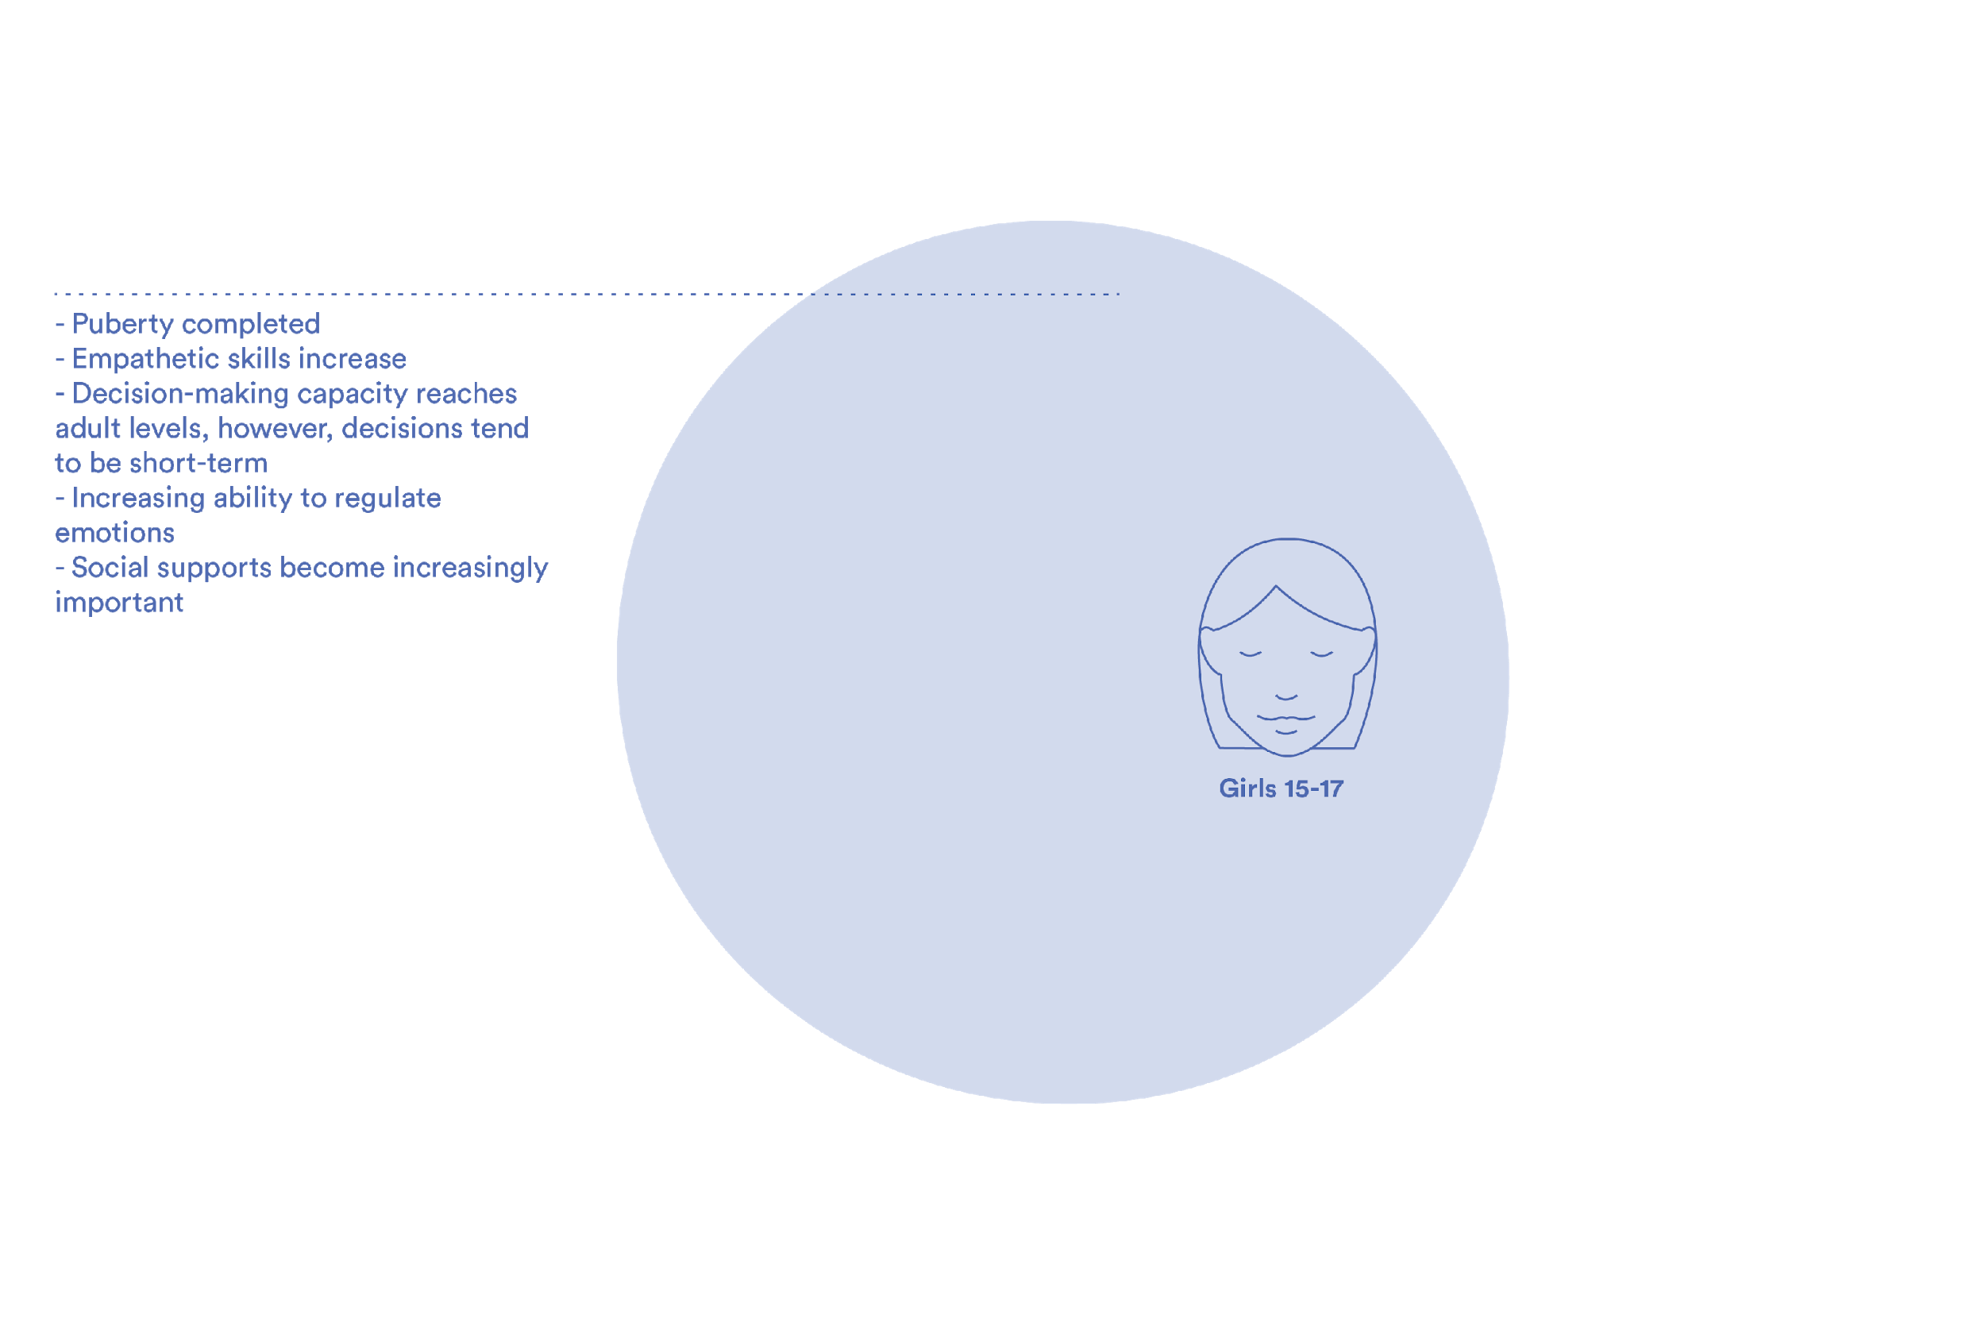
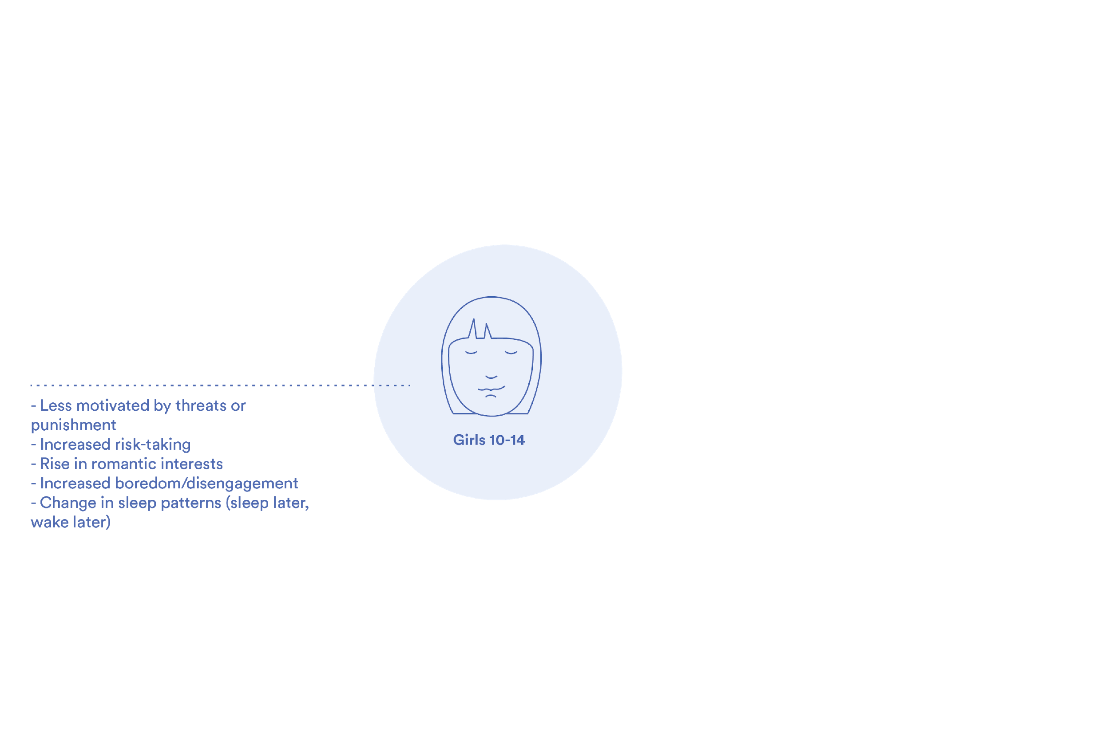
Three Distinct Stages
The Global Early Adolescent Study: Stages of Adolescence
Notes:
Early Adolescence (10-14), Middle Adolescence (15-17), and Late Adolescence (18-19 years)
In the early period, compared to childhood adolescents grow less motivated by threats or punishment. Risk-taking increases, and romantic interest rises. Disengagement and boredom often increases, and sleep patterns alter.
In middle adolescence, puberty completes. An adolescent’s ability to empathize increases. Decision-making capacity reaches adult levels, though decisions tend to be short-term. In addition, self-regulation of emotions grows. Social supports become increasingly important during this period.
In late adolescence, adolescents grow resistance to peer pressure. Susceptibility to depression increases. Adolescents become less influenced by fatigue and stress, and improve their impulse control.

Slide 7
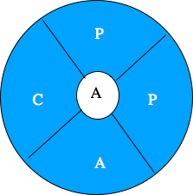
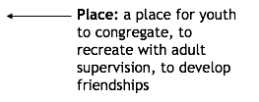
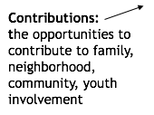
Context impacts adolescent development
Adolescence: The Age of Opportunity

Slide 8
How does this impact research?
How will conducting an interview with a 10 year old be different than with a 14 year old?
Growing independence
Social desirability bias
Future time prediction
Adolescence: The Age of Opportunity

